Slide 1
Literacy in Content Areas
Standards for Science, Social Studies, & Technical Subjects
Bjørn Wolter, Ph.D
Science Content Specialist
Department of Education & Early Development
bjorn.wolter@alaska.gov
Notes:
Welcome to an Introduction to the Alaska English/Language Arts & Mathematics Standards.

Slide 2
Preview
Review of ELA organization
Highlight:
Static elements of ELA standards
Changes to ELA standards
What do these changes really mean?
Extracting evidence from text
Thinking about text
Cross-cutting opportunities
Links to other initiatives
Notes:
Review of ELA organization
Highlight:
What remains the same in the new ELA standards
Changes to ELA standards
What do these changes really mean?
Extracting evidence from text
Thinking about text
Cross-cutting opportunities
Links to other initiatives

Slide 3
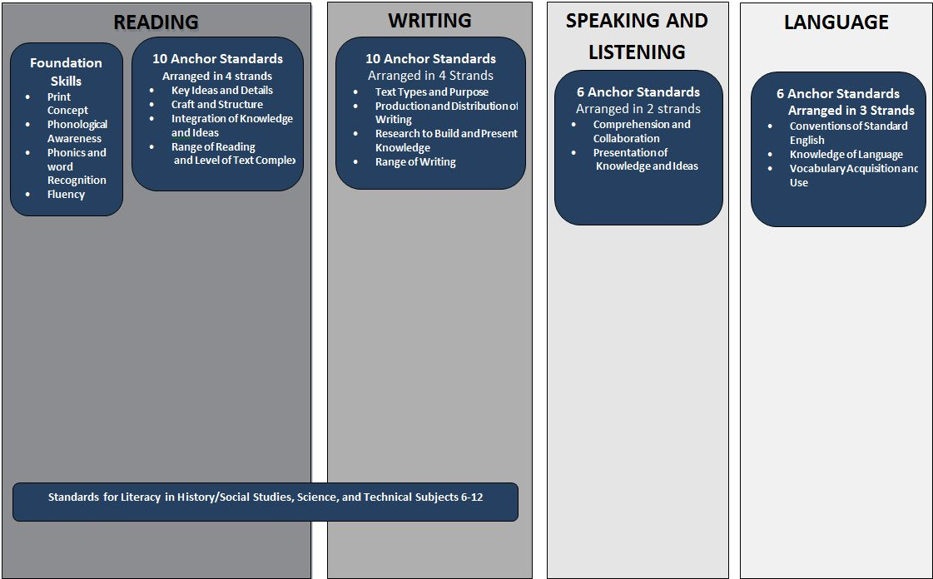
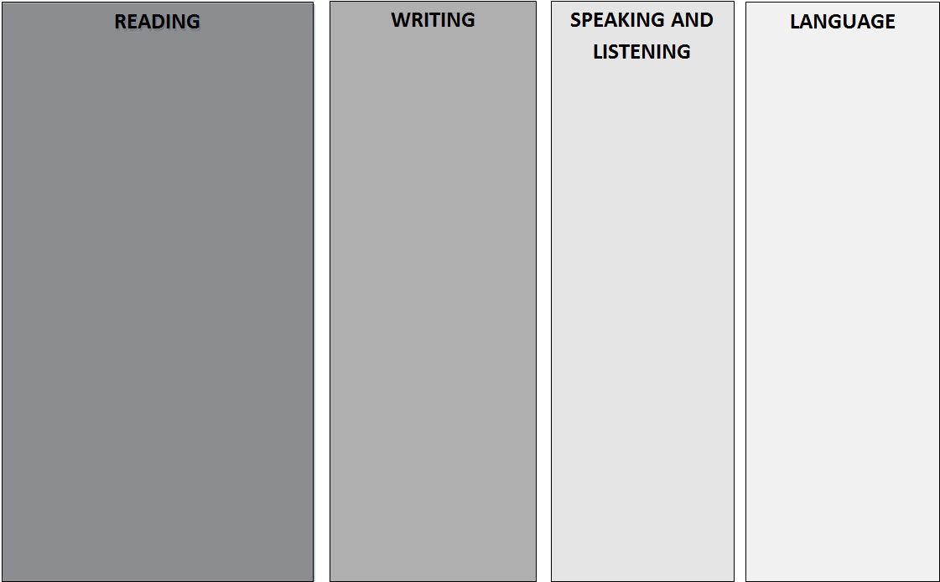
English Language Arts Organization
3
Notes:
Each grade level has grade specific standards that are linked to the anchor standards. This is the expectation of a particular standard at a particular grade level.
Specifically, there are two important things to note on this chart: (1) is the addition of an entire strand of informational text under “reading” for ALL grades, and (2) is the inclusion of the Standards for Literacy in History/Social Studies, Science, and Technical Subjects in grade 6-12. These standards do not address the content a student will be required to know about the subjects of History/Social Studies, Science, and Technical Subjects in grades 6-12. What these standards address is LITERACY within those content areas. How to read and write within these disciplines.

Slide 4
What Remained the Same
in the ELA Standards
Foundational Skills
The instruction of the basic reading components is still an expectation
The standards for these skill are found in grades K-5

Slide 5
What Shifted in English Language Arts
These apply to content area (social studies, science, and technical subject) teachers as well as to English teachers.
Building knowledge through content-rich nonfiction and informational texts in addition to literature.
Reading and writing grounded in evidence from the text.
Regular practice with complex text and its academic vocabulary.
Notes:
Three main shifts in ELA:
Students are taught to build knowledge through content-rich nonfiction and informational texts in addition to literature. The general recommendation is that 50% of what is taught/read by elementary students be Informational text and 70% of secondary level students.
That a student's reading and writing instruction and assessment is grounded in evidence from the text.
Students should have regular practice with complex text and its academic vocabulary.

Slide 6
What Does this Mean to Me?
Notes:
Regardless of what subject one teaches, reading, writing, and speaking and listening need to be integral parts of content classes in the future.

Slide 7
Evidence From the Text
Students should be able to critically and analytically read text to:
Determine the central thesis
Access key vocabulary
Identify author’s perspectives and purpose
Distinguish between fact and opinion
Understand source information and citations
Read, analyze, and create visual data (e.g. charts, graphs, maps, etc…)
Notes:
The are three semi-separate sections of standards under Content Literacy:
Reading for History/Social Studies
Reading for Science and Technical subjects
Writing in History/Social Studies, Science, and Technical Subjects
The differences are subtle, so I have just synthesized the main points here…
Students should be able to critically and analytically read text to:
Determine the central thesis
Access key vocabulary
Identify author’s perspectives and purpose
Distinguish between fact and opinion
Understand source information and citations
Read, analyze, and create visual data (e.g. charts, graphs, maps, etc…)

Slide 8
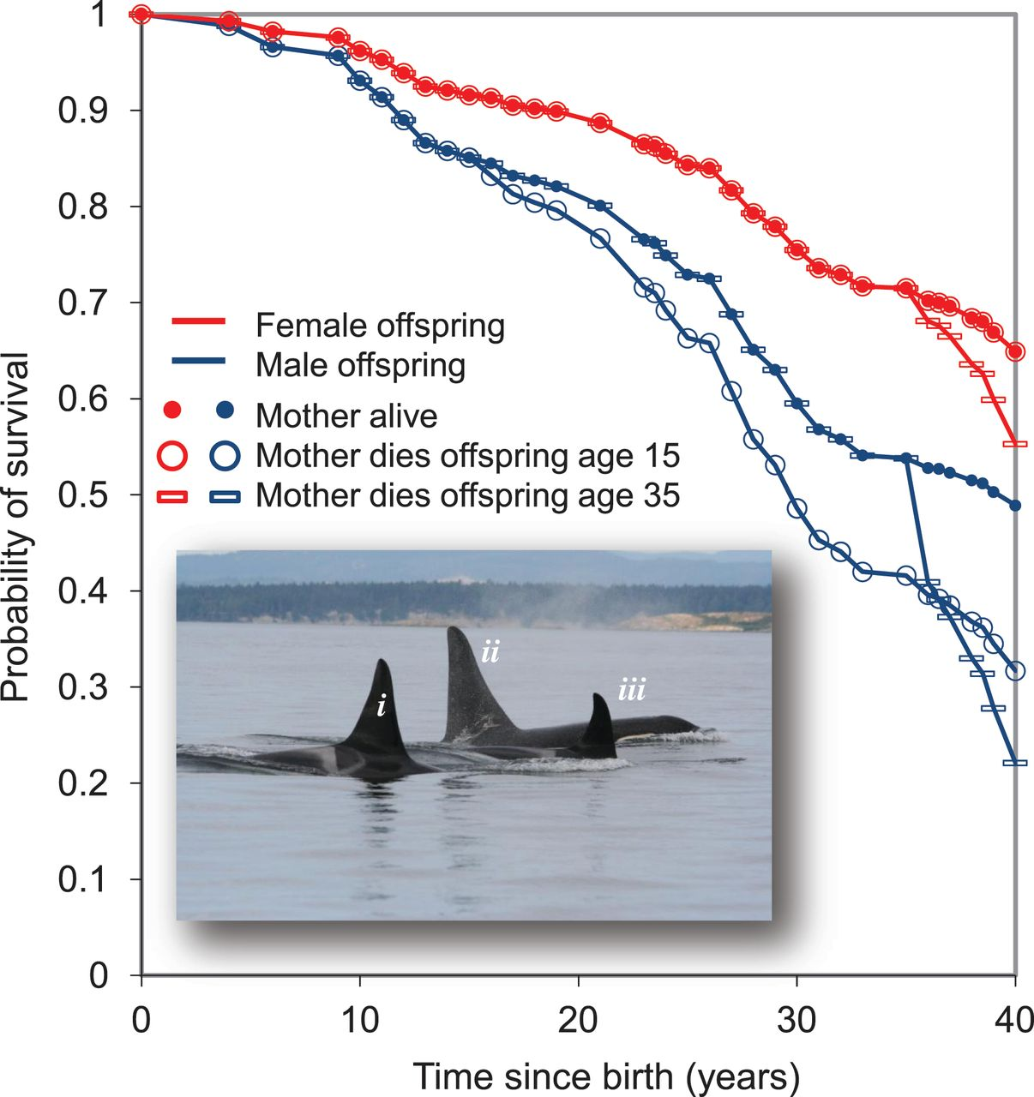
Examples
“Mutations in µ-BLM, which encodes a RecQ helicase, give rise to Bloom's syndrome, a disorder associated with cancer predisposition and genomic instability. A defining feature of Bloom's syndrome is an elevated frequency of sister chromatid exchanges. These arise from crossing over of chromatid arms during homologous recombination…”
Wu and Hickson (2003). Nature 426(6968): 870-874
Foster et al. (2012). Science 337(6100): 1313.
Notes:
So, unless you are a biologist, you probably have only a vague idea of what that passage actually said. This is a perfect example of the need for literacy in subject areas. This passage alone requires students to access:
Discipline specific vocabulary
Analytical reading skills
Ability to decipher symbols
Skills to determine the central theme
Now let’s look at another example. This graph shows the probability of survival charted against time for Orcas found off the western Canadian coast. You’ll see that there are several data trend lines and markers mixed with color coded data. So there is a LOT of information being presented in this graph. From this graph alone, students must:
Determine meaning of symbols
Analyze data and interpret data relationships
Translate quantitative data from visual to spoken word and vice versa
Make hypotheses and support their perspectives from the given information

Slide 9
Reflection
On a post-it note, write down two ways that you think the inclusion of these literacy standards might affect you and/or your district.
Please share your ideas with your neighbor.

Slide 10
Thinking about text
Accessing
Sharing
Processing
Notes:
This is the process distilled. The new standards require students to engage in a cyclical progression for evaluating and sharing information within disciplinary areas. To do that, students must be able to:
Access the information, wherever it is. This could be in the form of text, video, oral presentations (like mine today), or any of a whole host of other media forms that we use to communicate information today.
Students need the skills to process that information! It is all well and good for a student to be able to read a high lexile level passage, but if they cannot comprehend, digest, and internalize that information, what good is that ability? In all subject areas, from national to state levels, standards are intentionally moving away from emphasizing the rote memorization of facts toward focusing on student comprehension of materials. It is true of the new state ELA and Math standards, and it is certainly true of the Next Generation of Science Standards being developed at the national level.
This is an absolutely vital 21st century skill. Students absolutely must be able to effectively and clearly communicate with not only their peers but also the general public. This takes the form of both technical and informal writing, oral presentations (again, like mine today), informal discussion, and digital media.
This triad of skills can be applied across content areas, and frankly is something that universities, colleges, and employers are demanding of applicants. Let me put my scientist hat back on here and share a short tangential story with you. In my other life, I study college level life sciences students, specifically those going into natural resources areas. One of the recent studies a colleague and I have done is asking employers what sorts of skills they need students to walk away from their educations having down pat. Now, you’d think it’d be content specific information, right? Stuff like how to set a transect or measure DBH (tree diameter at breast height, which is a measure of standing biomass). But no. Consistently what we were told by employers is, “We can teach them all that. What we cannot teach them is how to work effectively in groups, how to communicate, independent research skills, and the ability to synthesize data and information.”
This triangle really forms the nexus of skills that students will need to be both College and Career Ready, regardless of their area of focus. And that is really what this is all about, right? Making sure our students are prepared prospective challenges and compete within the state, across the nation, or around the globe – wherever their future might take them.

Slide 11
Access
Analytical reading
Critical thinking
Building vocabulary
Notes:
OK, so that was kind of heavy. But, if you break it down and take it piece-by-piece, this really is a pretty simple process – in fact, it is exactly what I had to do to give this presentation today. I am not a literacy specialist. I am a scientist. But, here I am talking to you today about literacy. For me to do that I had to bust out some skills to access the information about disciplinary literacy in the state ELA standards.
I had to critically read the standards
I had to parse out what the main point of each standard was
Well, to do that I obviously had to learn some new words, like “lexile level” and “phonemic awareness”

Slide 12
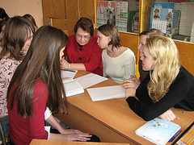
Process
Logical development
Argumentation
Data collection and analysis
Notes:
Once I’d taken in all that information, I had to process it.
I had to cogitate a bit on what I thought that actually meant
I had to put it in some order that made sense to me (and hopefully to you too!)
I had to clearly lay out the information and make my case for it
I had to pull together supporting information and documents

Slide 13
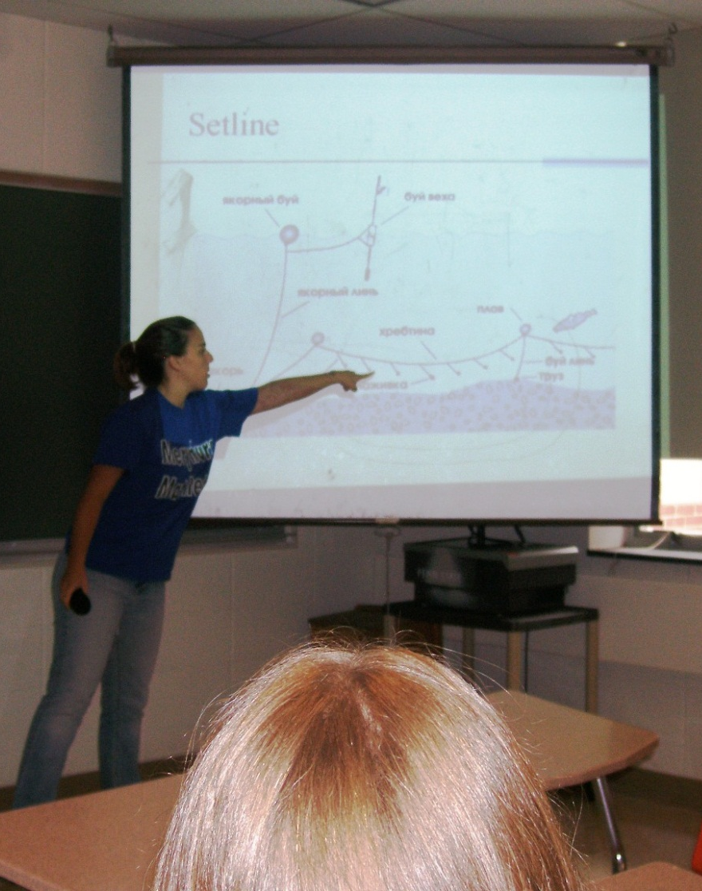
Discourse
Translation of ideas
Technical writing
Public speaking
Critical listening
Notes:
THEN, I had to put together this truly exceptional PowerPoint presentation for you all. And that required me to:
Translate source information and my ideas into language that anyone could potentially access. To do that, one really has to know the information, because you’re distilling it down to it’s essence. And the thing about distillation (working science back into the discussion here) is that it concentrates what was originally there, so if you’re beginning with an imperfect concept, that is only going to be magnified. So this step is a really excellent check to determine if you’ve got it right. (I did this by sending a frantic note to our literacy specialist Karen with my ideas. She looked at it, pulled me off the wall, and told me I’d pretty much got it right.)
Then I had to put together this PowerPoint. Now, even though I’m conducting it in a less than formal manner, this represents a very real aspect of technical writing, and proficiency in developing presentations is just as valuable a skill as say being able to write a journal article, or technical report.
Finally I had to give the presentation. And I feel that presenting can really be broken into two skill sets –
First you need the ability to speak in front of people. For some that’s a skill that comes naturally. For others it takes some practice. And if you are unlucky enough to be a nerdy science introvert, it is perhaps something that one has to develop over years.
Second, and I think this is a skill that is often overlooked in presenting, a good presenter is also a good listener. You react to your audience. You listen to both the spoken and unspoken cues they are communicating back to you to refine your presentation on the fly. Critical listen skills help a presenter be more dynamic. And dynamic presenters are just more fun to listen to. We’ve all had that professor in college (possibly in math, never in science) who just stood in front of the class and droned on and on and on while your mind checked out and your neighbor started to drool. We don’t want that.

Slide 14
Cross-Cutting Opportunities
ELA
Physics
Biology
Music
History
Chemistry
Civics
Math
Drama
These standards create connections not just between ELA & subject areas, but also among subject areas.
Notes:
OK. I’ve just hit you with a lot of information, so let’s take a break here for a second. Stretch. Deep breath in. Slow out.
OK.
So I think it is important to note here that there are multiple opportunities to build connection across disciplines using these new standards as a foil.

Slide 15
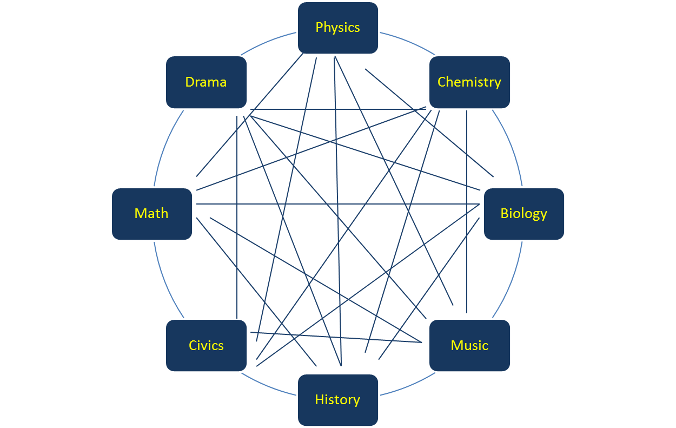
Cross-Cutting Opportunities
ELA tools are the glue to one can use to combine multiple, seemingly disparate content areas. (e.g. Drama & Science & History)
Notes:
OK. I’ve just hit you with a lot of information, so let’s take a break here for a second. Stretch. Deep breath in. Slow out.
OK.
So I think it is important to note here that there are multiple opportunities to build connection across disciplines using these new standards as a foil.

Slide 16
Fit with Other Initiatives
Scientific and Engineering
Practices:
Defining problems
Planning & carrying out investigations
Analyzing & interpreting data
Constructing explanations
Engaging in argument from evidence
Obtaining, evaluating, & communicating information

Slide 17
Turn and Talk
As you consider the standards for literacy in content areas, what is your BIGGEST concern?
Considering the new literacy standars, what are you most enthusiastic about?

Slide 18
Contact information
Bjorn Wolter
bjorn.wolter@alaska.gov
907.465.6542

