Slide 1
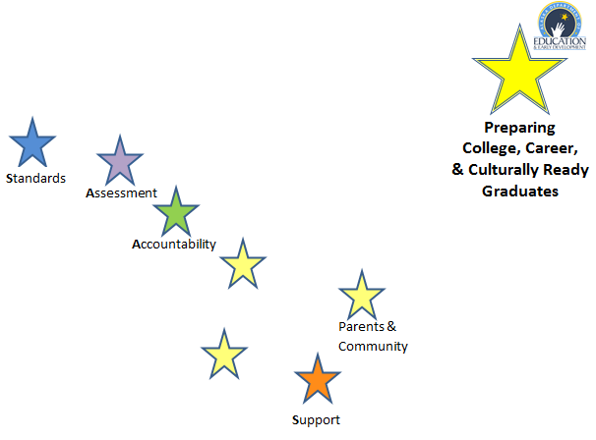

Slide 2
Alaska Mathematics Standards: Content and Mathematical Practice
Providers’ Conference
August 29-30

Slide 3
Shifts in Mathematics
Focus: 2-3 topics focused on deeply in each grade.
Coherence: Concepts logically connected from one grade to the next and linked to other major topics within the grade.
Rigor: In major topics pursue conceptual understanding, procedural skill and fluency, and application with equal intensity.
Notes:
In the mathematics standards, there are three shifts which will encourage changes to instructional practices and curriculum.
Focus:
For each grade there are fewer big ideas to be covered. Rather than racing to cover topics in a mile-wide, inch deep curriculum, teachers significantly narrow and deepen the way time and energy is spent in the classroom. They focus deeply on the major work of each grade so that students can gain strong foundations: solid conceptual understanding, a high degree of procedural skill and fluency, and the ability to apply the math they know to solve problems inside and outside the math classroom.
Coherence:
Linking to major topics: Instead of allowing additional or supporting topics to detract from the focus of the grade, these topic can serve the grade level focus. For example, instead of data displays as an end in themselves, they support grade-level word problems.
Rigor:
Conceptual Understanding: Teachers support students’ ability to access concepts from a number of perspectives so that students are able to see math as more than a set of mnemonics or discrete procedures.
Procedural skill and fluency: The standards call for speed and accuracy in calculation. Class time and homework is structured for students to practice core functions such as single-digit multiplication so that students have access to more complex concepts and procedures.
Application: The standards call for students t use math flexibly for applications. Opportunities are provided to apply math in context. Teacher in content areas outside of math, particularly science, ensure that students are using math to make meaning of the content.

Slide 4
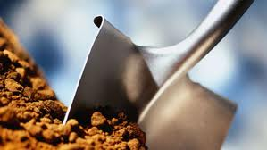
Shift 1: Focus Multiplication Grade 3
New Math Standards
GLE
Represent and solve problems involving multiplication.
3.OA.1, 3.OA.2, 3.OA.3, 3.OA.4
Understand properties of multiplication and the relationship between multiplication and division.
3.OA.5, 3.OA.6,
Multiply and divide up to 100.
3.OA.7
Solve problems involving the four operations and identify and explain patterns in arithmetic.
3.OA.8, 3.OA.9
Use place value understanding and properties of operations to perform multi-digit arithmetic.
3.NBT.3
M3.1.4 Model multiplication as repeated addition and grouping objects; model division as “sharing equally” and grouping objects
[3] E&C-5, [3]E&C-6
Digging Deeper
Notes:
Provides a focused sense of what to teach.
Teaching with additional depth allows the freedom to let go of some material.
Gets away from rote memorization moving toward mastery.
Depth vs breadth
Provides deep procedural knowledge and conceptual understanding

Slide 5
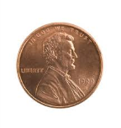
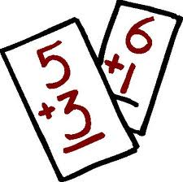
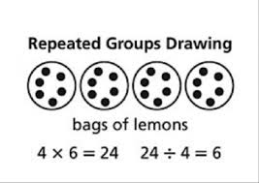
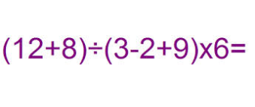
Shift 2: Coherence
Represent addition and subtractions with objects.
Solve single step addition and subtraction word problems.
Estimate and solve multistep addition and subtraction word problems.
Multiplication (repeated addition)
Division (repeated subtraction)
Recognize multiplication as a comparison (commutative property).
Use parentheses to construct numerical expressions and evaluate expressions with these symbols.
Grade Level
K
1
2
3
4
5
K.OA.1
1.OA.1
2.OA.1
3.OA.1, 3.OA.2
4.OA.1
5.OA.1
Craig has $20. He buys 6 squirt guns for $2 each. How much money does he have left?
5x7 = 7x5

Slide 6
Algebra
Notes:
Many students do well in mathematics until they reach algebra. They hit a wall.
The standards help create ramp to help students get up the cliff.
In order to create habits of mind and gain a deep understanding of mathematical concepts:
Students need thoughtful conversation in a vibrant classroom (coherence),
This is not possible in a classroom that is scrambling to cover everything (focus).
All roads lead to Algebra

Slide 7
Shift 3
Rigor
Conceptual understanding
Application to real-world situations
Fluency with arithmetic
With equal intensity

Slide 8
Rigor
Conceptual understanding of key concepts.
Foster students’ ability to access concepts from a number of perspectives
math is seen as more than a set of mnemonics or discrete procedures.

Slide 9
Priorities in Mathematics
Grade | Priorities in Support of Rich Instruction and Expectations of Fluency and Conceptual Understanding
K-2 | Addition and subtraction, measurement using whole numbers
3-5 | Multiplication and division of whole numbers and fractions
6 | Ratios and proportional relationships; early expressions and equations
7 | Ratios and proportional relationships; arithmetic of rational numbers
8 | Linear algebra

Slide 10
Required Fluencies in K-6
Grade | Standard | Required Fluency
K | K.OA.5 | Add/subtract up to 5
1 | 1.OA.6 | Add/subtract up to 10
2 | 2.OA.2 2.NBT.5 | Add/subtract up to 20 (know single-digit sums from memory) Add/subtract up to 100
3 | 3.OA.7 3.NBT.2 | Multiply/divide up to 100 (know single-digit products from memory) Add/subtract up to 1000
4 | 4.NBT.4 | Add/subtract up to 1,000,000
5 | 5.NBT.5 | Multi-digit multiplication
6 | 6.NS.2,3 | Multi-digit division Multi-digit decimal operations
Notes:
Fluent means “fast and accurate”.
Some fluency expectations are meant to be mental and others with pencil and paper. But for each, there should be no hesitation in getting the answer with accruacy.

Slide 11
Application
Students can use appropriate concepts and procedures for application even when not prompted to do so.
Teachers provide opportunities at all grade levels for students to apply math concepts in “real world” situations, recognizing this means different things in K-5, 6-8, and HS.
Teachers in content areas outside of math, particularly science, ensure that students are using grade-level-appropriate math to make meaning of and access science content.

Slide 12
Mathematical Practices

Slide 13
Standards for Mathematical Practice
Embedded standards at every grade level to establish habits of mind that will empower students to become mathematically literate.
Procedural fluency
Development of concepts
Application of knowledge
Self-assessment

Slide 14
Standards for Mathematical Practice
Make sense of problems and persevere in solving them.
Reason abstractly and quantitatively.
Construct viable arguments and critique the reasoning of others.
Model with mathematics.
Use appropriate tools strategically.
Attend to precision.
Look for and make use of structure.
Look for and express regularity in repeated reasoning.

Slide 15
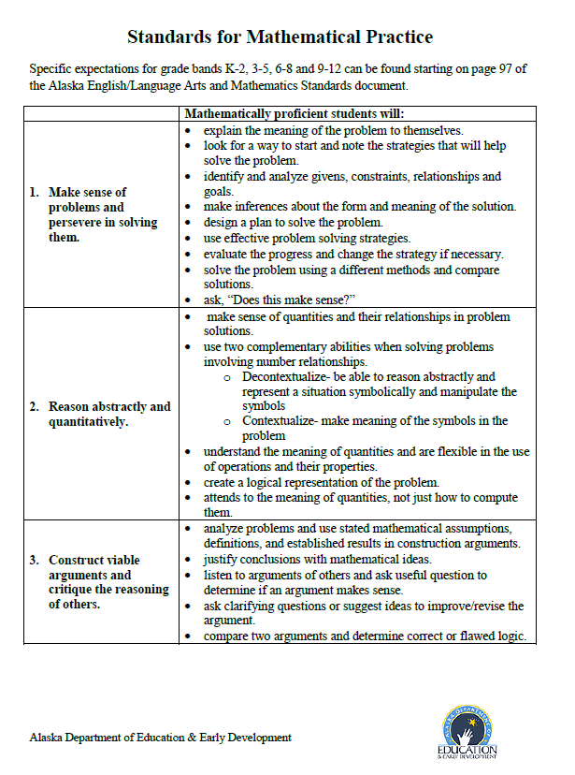
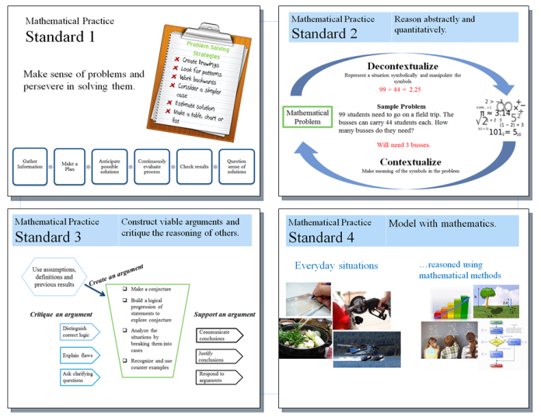
Resources on the Flash Drive

Slide 16
Mathematics Standards
Understanding

Slide 17
Performance Tasks

Slide 18
Performance Tasks
Activities that give students the opportunity to demonstrate their understanding and mastery of math skills and concepts covered in class.
Students
Use an organized approach using one or more strategies
Explain the steps and strategies used to complete the task
Show evidence of checking answers for correctness and reasonableness.
The tasks require analysis to explain the methods used and the reasoning behind choosing the method.
http://insidemathematics.org/index.php/exemplary-lessons-integrating-practice-standards

Slide 19
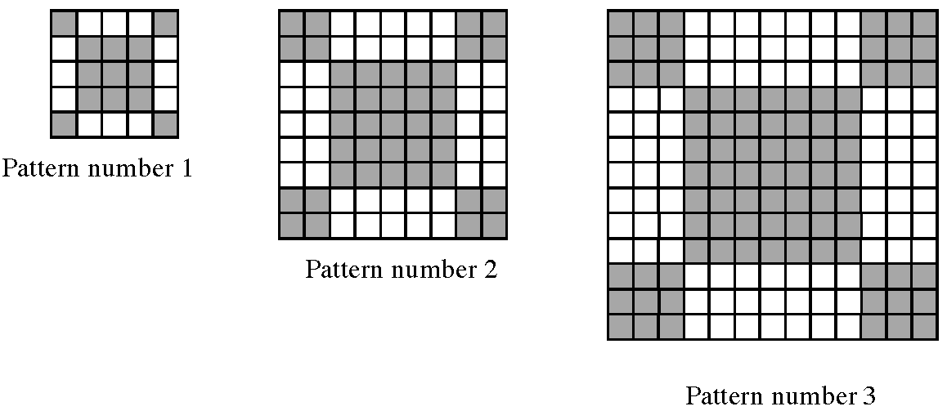
Sidewalk Patterns
In Prague some sidewalks are made of small square blocks of stone.
The blocks are in different shades to make patterns that are in various sizes.
1. Draw the next pattern in this series.
National Council of Supervisors of Mathematics. http://www.mathedleadership.org/ccss/itp/sidewalk.html
Notes:
This task will be used as a vehicle to explore the CCSS Content and Practice Standards. First we will do the task and discuss it, then we will examine some student artifacts from this task and attempt to identify evidence of some of the practices related to seeing structure and generalizing in high school.
Pass out copies of the Sidewalk Pattern Task. Use this slide and the next two to assist you in previewing the task.
Facilitators may want to use an article from the Mathematics Teaching in the Middle Grades Volume 15, Number 1, August 2009 by Susan N. Friel and Kimberly A. Markworth entitled “ A Framework for Analyzing Geometric Pattern Task” in their preparation for facilitating this task.
http://www.nctm.org/publications/article.aspx?id=24871

Slide 20
2. Complete the pattern below
3. What do you notice about the number of white and gray blocks?
Fill in the blank spaces in this list
25=5² 81=_____ 169=_____ 289=17²
b. How many blocks will pattern 5 need?
c. How many blocks will number n need?
Pattern number, n | 1 | 2 | 3 | 4
Number of white blocks | 12 | 40
Number of gray blocks | 13
Total number of blocks | 25
National Council of Supervisors of Mathematics. http://www.mathedleadership.org/ccss/itp/sidewalk.html

Slide 21
Task Based Instruction
Use performance tasks
Focus on Mathematical Practices
Students should be challenged and struggle
Guide with open ended questions
Allow students to work together to solve problems
Click the puzzle to view clip.

Slide 22
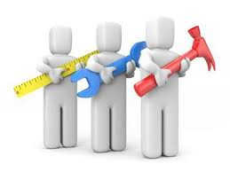
Great Tasks
Revolve around an interesting problem that offers several methods of solution.
Addresses an essential mathematical concept outlined in the Alaska Standards.
Utilizes the Mathematical Practices.
Adapted from Schrock, C. (2013, Jan 15). Great tasks [Webinar]. NCSM Great Tasks for Mathematics. Retrieved from http://www.mathedleadership.org/events/webinars.html

Slide 23
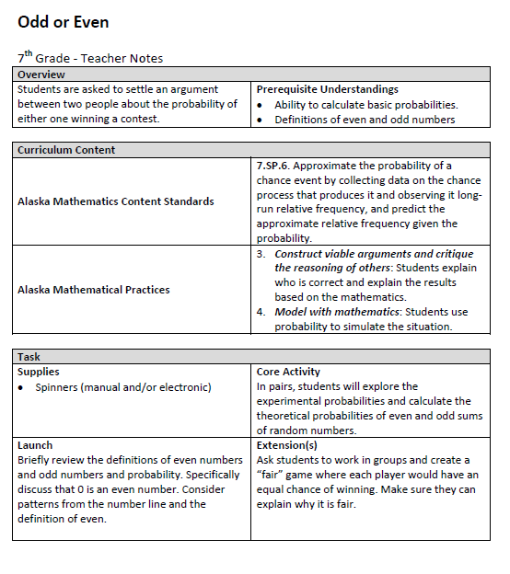
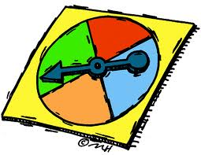
Sample Performance Task
Outline
http://www.mathplayground.com/probability.html

Slide 24
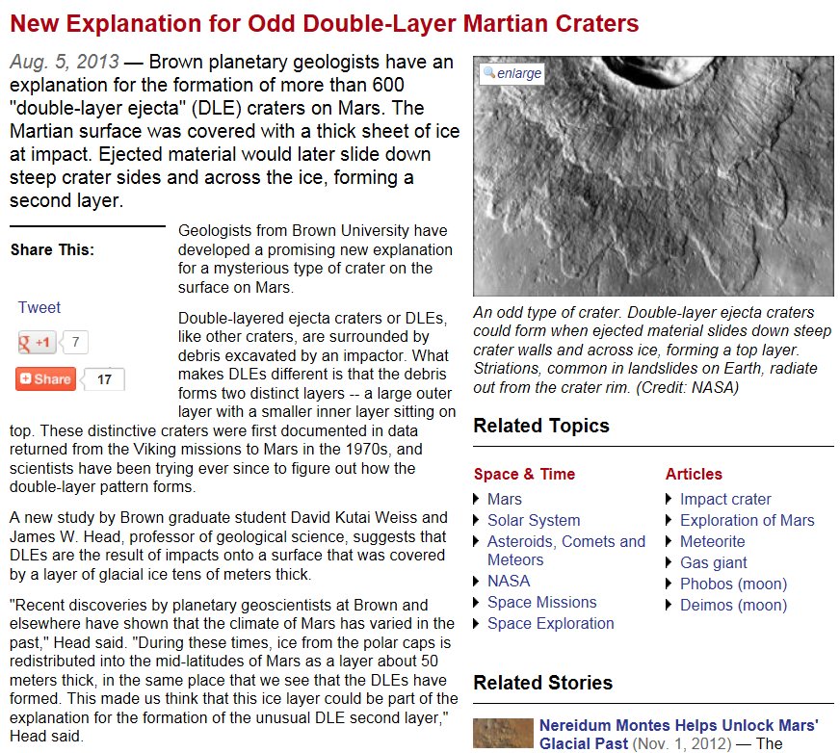
Brown University (2013, August 5). New explanation for odd double-layer Martian craters

Slide 25
Lesson Planning Model
Adapted from Measured Progress Professional Development www.measuredprogress.org

Slide 26
Lesson Planning Model
Self Reflection:
Complete this sentence independently, “It is important to know when a specific tpe of average is needed because……”. Be sure to connect it to today’s learning target.
Activating Prior Knowledge:
Students complete “Frayer Model” with word average in the center
Review Learning Target(s)
Students can stop light their current knowledge.
Mini Lesson:
What is the difference between the following types of “average”? Mean, median , mode.
Learning Targets
I can determine the average of a set of numbers
I can use between 3-5 vocab words from the statistics unit.
I can show my understanding of math through the use of visual representation

Slide 27
Resources
Illustrative Mathematics

Slide 28
Contact Information
Deborah Riddle
Math Content Specialist
deborah.riddle@alaska.gov
907-465-3758

