Slide 1
CTE and
The Alaska English Language Arts
and Math Standards

Slide 2
Alaska English/Language Arts Standards
Karen Melin
Administrator of Instructional Support
Alaska Department of Education & Early Development
Notes:
Welcome to an Overview of Alaska’s Alaska Standards for English/Language Art. Thank you for taking the time to join me today.

Slide 3
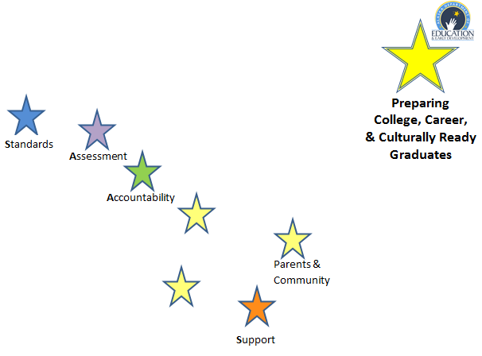

Slide 4
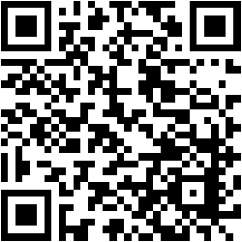
Handouts Online
http://www.livebinders.com/play/play?tab_layout=side&id=1117828

Slide 5
Goals
Gain a greater understanding of the structure of the Alaska English Language Arts Standards
Explore connections between Alaska English Language Arts Standards and CTE course

Slide 6
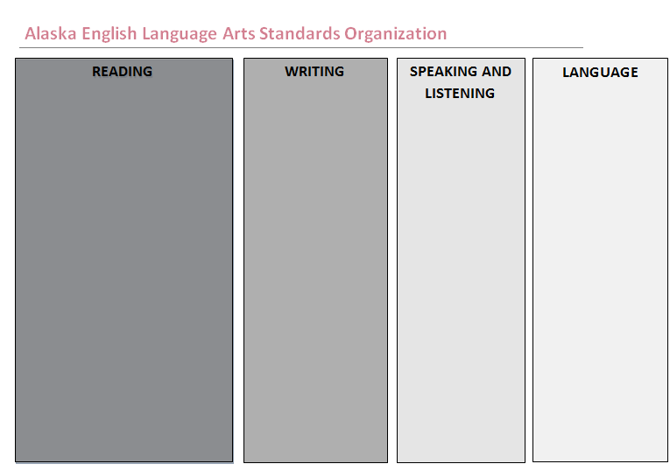
Notes:
The Alaska ELA Standards are organized in four content areas. Reading, Writing speaking and Listening and Language.

Slide 7
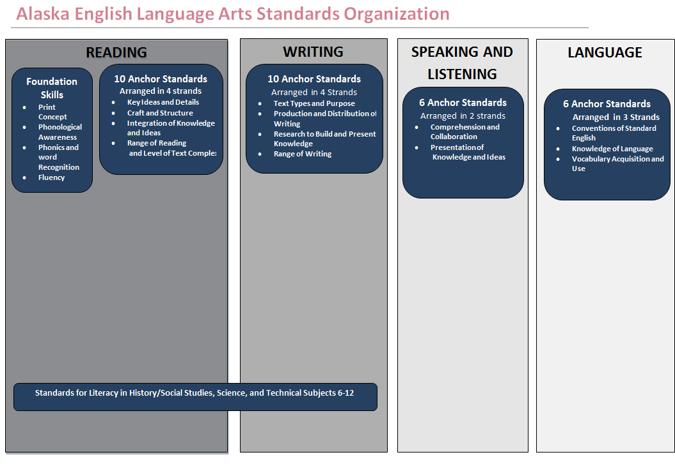
Notes:
Each content area has a set of Anchor Standards. These are those standards that were identified as what students should be able to do by the end High School to be ready for college or a chosen career. The standards are the organized into clusters called strands.

Slide 8
Reading
Literature and Informational Text
Reading
Foundational Skills
Writing
10 Anchor Standards Arranged in 4 strands
Key Ideas and Details
1.
2.
3.
Craft and Structure
4.
5.
6.
Integration of Knowledge and Ideas
7.
8.
9.
Range of Reading and Level of Text Complexity
10.
Arranged in 4 strands
Print Concept
1.
Phonological Awareness
2.
Phonics and Word Recognition
3.
Fluency
4.
10 Anchor Standards Arranged in 4 strands
Text Types and Purpose
1.
2.
3.
Production and Distribution of Writing
4.
5.
6.
Research to Build and Present Knowledge
7.
8.
9.
Range of Writing
10.
Notes:
Welcome to an Introduction to the Alaska English/Language Arts & Mathematics Standards.

Slide 9
Speaking and Listening
Language
6 Anchor Standards Arranged in 2 strands
Comprehension and Collaboration
1.
2.
3.
Presentation of Knowledge and Ideas
4.
5.
6.
6 Anchor Standards Arranged in 3 strands
Conventions of Standard English
1.
2.
Knowledge of Language
3.
Vocabulary Acquisition and Use
4.
5.
6.
Notes:
Welcome to an Introduction to the Alaska English/Language Arts & Mathematics Standards.

Slide 10
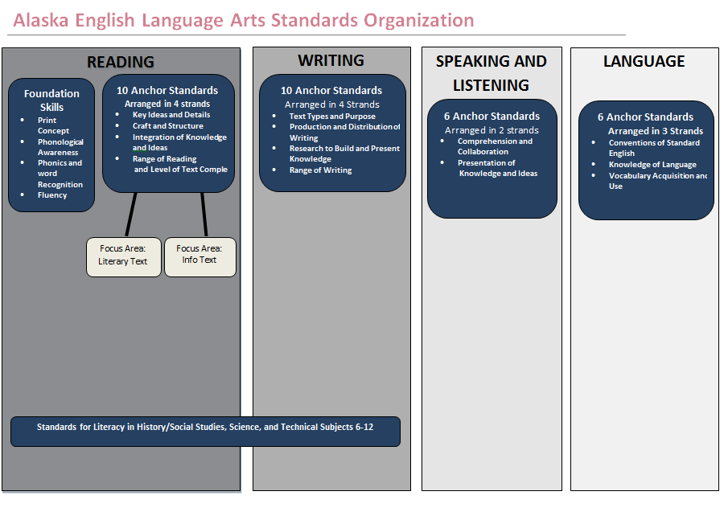
Notes:
The content area of Reading is divided into focus areas. Reading literature (10 standard), reading informational texts (10 standards) and at grades k-5 reading foundational skills. The speaking and listening Content area contains 6 standards and the language content area which also contains 6 standards includes vocabulary and conventions. Vocabulary and conventions are treated in their own strand not because these areas should be handled in isolation, but because their use extends across reading, writing, speaking and listening.

Slide 11
Notes:
The anchor standards are then backward mapped to the grade specific standard. Those are the expectation of a particular Anchor Standard in a particular grade level. The grade specific standards are organized by individual grades in kindergarten through grade 8. In high school the standards are organized in grade bands of 9-10 and 11-12.
The standards for these skills are targeted in grades K-5. The expectation is that these skills should be mastered by 5th grade so they can be utilized throughout the rest of a student's academic career.
Also as a part of the Alaska Standards for ELA are the Standards for Literacy in History/Social Studies, Science, and Technical Subjects in grades 6-12

Slide 12
Standards for Literacy in History/Social Studies, Science, and Technical Subjects grades 6-12
READING
WRITING
10 Anchor Standards Arranged in 4 strands
Key Ideas and Details
Craft and Structure
Integration of Knowledge and Ideas
Range of Reading and Level of Text Complexity
10 Anchor Standards
Arranged in 4 Strands
Text Types and Purpose
Production and Distribution of Writing
Research to Build and Present Knowledge
Range of Writing
Grade Specific Standards
Grade Specific Standard
6-8
9-10
11-12
6-8
9-10
11-12
Standards for Literacy in History/Social Studies, Science, and Technical Subjects 6-12
Notes:
These standards do not address the content a student will be required to know about the subjects of History/Social Studies, Science, and Technical Subjects in grades 6-12. What these standards address is LITERACY within those content areas, or, how to read and write within these disciplines.
There are only standards for reading and writing, have the same anchor standards as reading and writing and are grouped into 3 grade groups, 6-8, 9-10, 11-12.

Slide 13
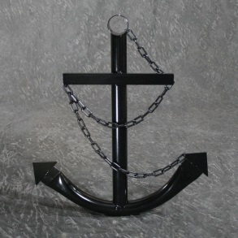
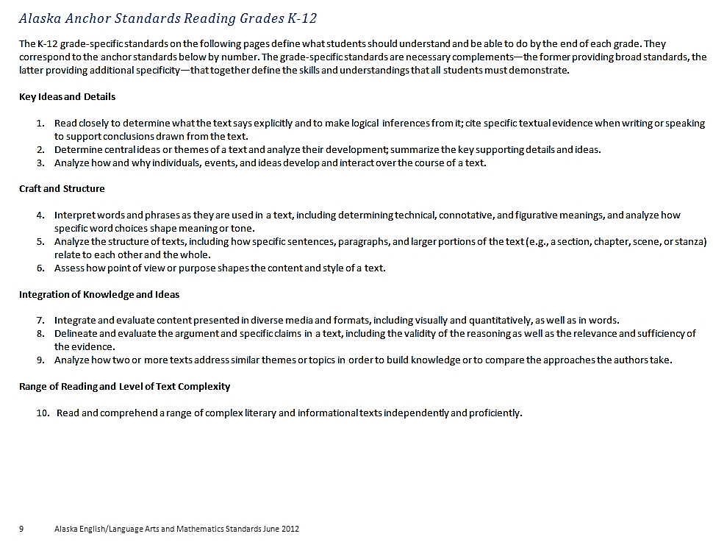
Reading Anchor Standards

Slide 14
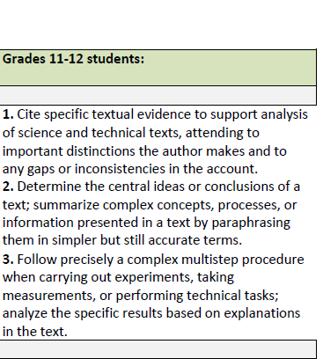

Slide 15
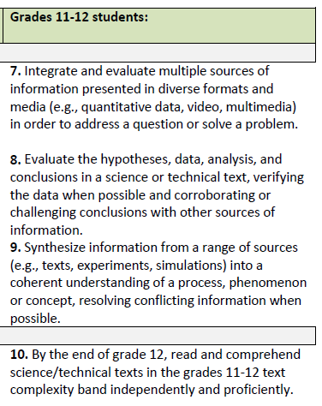

Slide 16
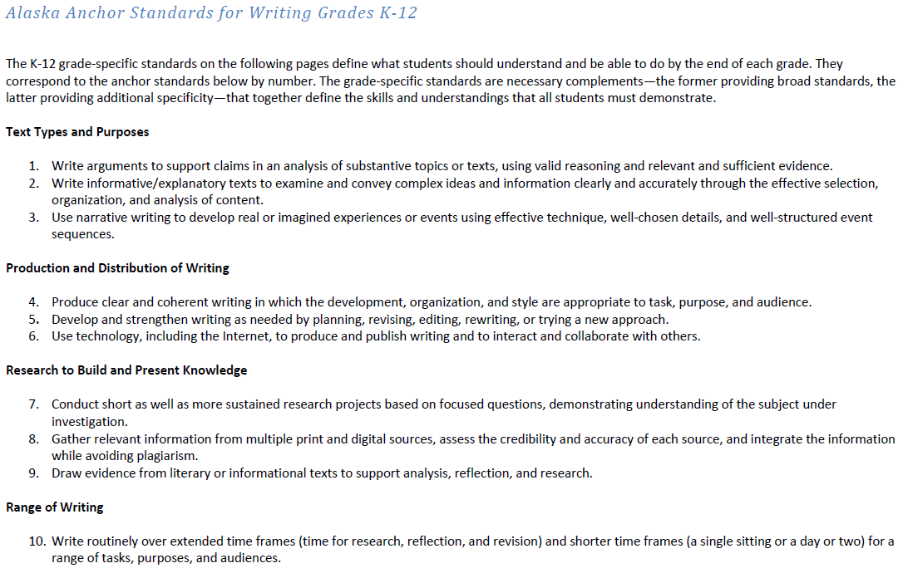
Writing Anchor Standards

Slide 17
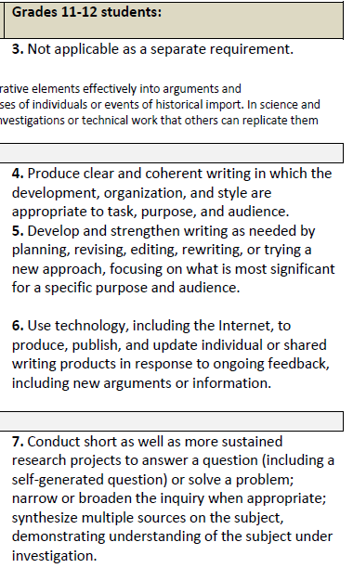

Slide 18
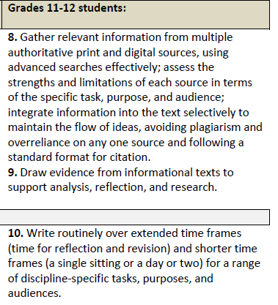

Slide 19
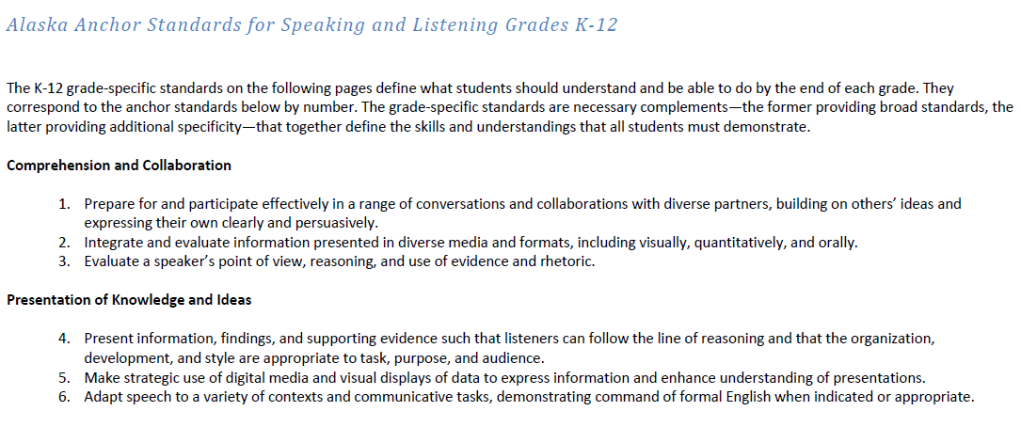
Speaking and Listening Anchor Standards

Slide 20
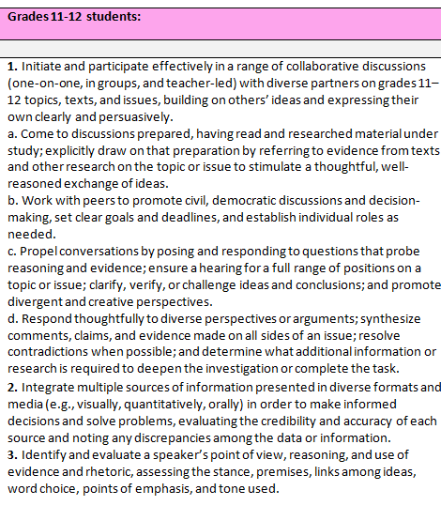

Slide 21
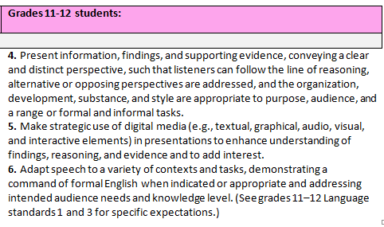

Slide 22
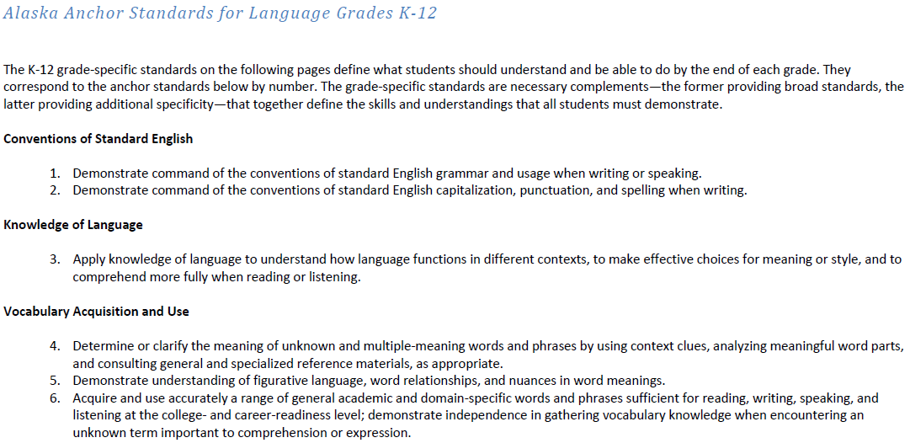
Language Anchor Standards

Slide 23
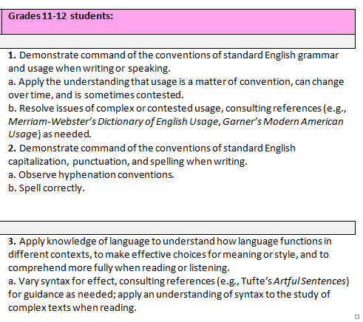

Slide 24
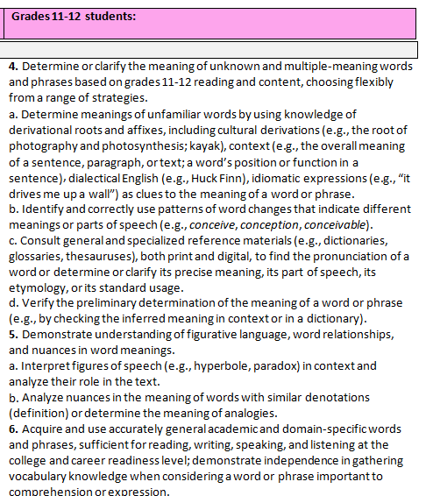

Slide 25
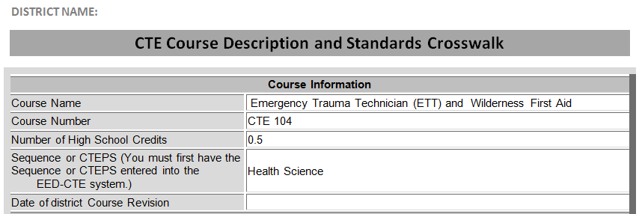
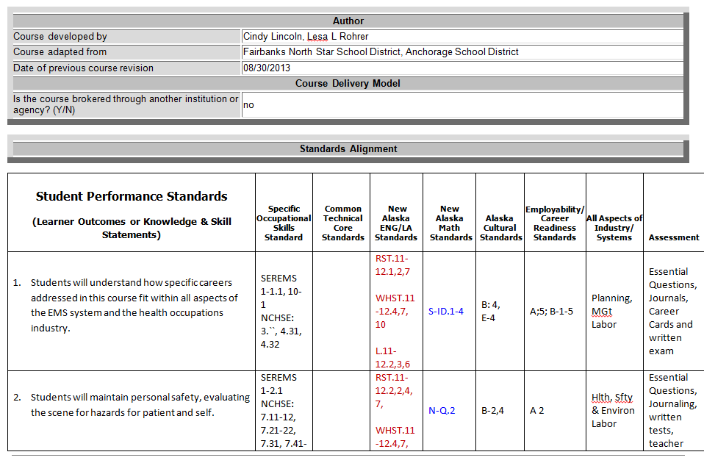

Slide 26
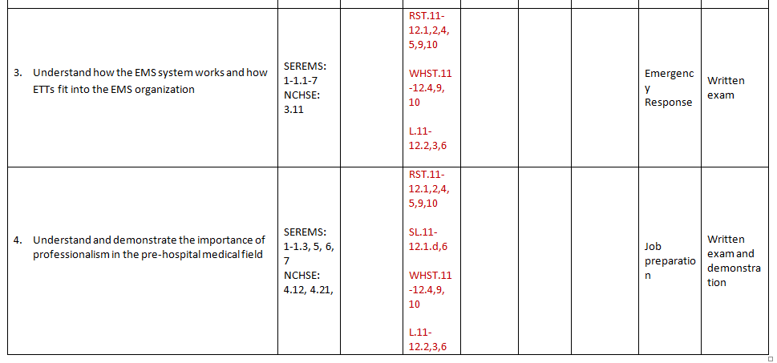

Slide 27
Goals
Gain a greater understanding of the structure of the Alaska English Language Arts Standards
Explore connections between Alaska English Language Arts Standards and CTE course

Slide 29
Contact Me!
Karen Melin, Language Arts Content Specialist
karen.melin@alaska.gov, 907-465-6536
Notes:
Here are key contacts for the new Alaska Standards.

Slide 30
Alaska Mathematics Standards
CTE Conference
October 28, 2013
Deborah Riddle
Math Content Specialist
Alaska Department of Education & Early Development

Slide 31
Handouts Online
http://www.livebinders.com/play/play?tab_layout=side&id=1117828

Slide 32
Goal for Today
Examine the Standards for Mathematical Practice
Navigate the Conceptual Categories

Slide 33
Structure of the Standards
Content Standards
Standards for Mathematical Practice

Slide 34
Eight Mathematical Practices
Activity:
Groups of 8
Pass out the Practices
Learn your practice and teach your group.

Slide 35
Conceptual Categories
Career and college ready math standards
Coherent view of high school mathematics
Standards cross traditional course boundaries

Slide 36
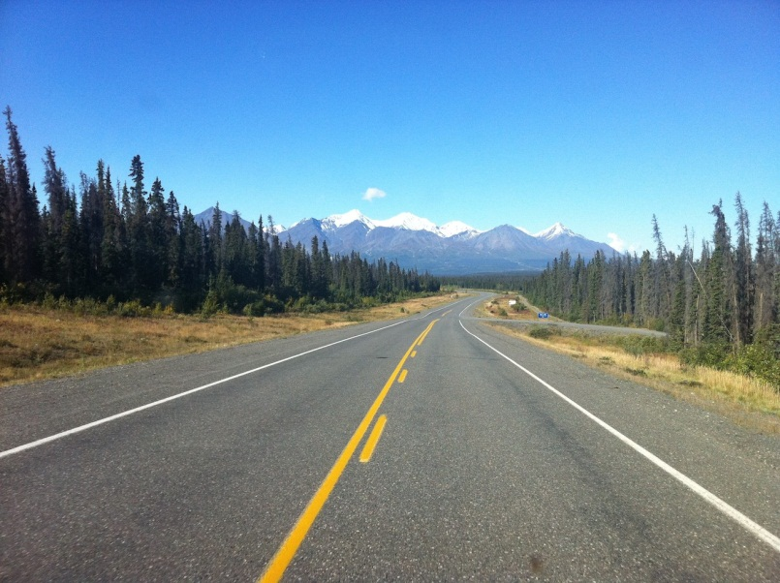
Pathways
No mandated sequence of courses
Freedom for districts to design courses to meet their needs
Traditional
Integrated

Slide 37
Modeling
Link classroom math to
everyday life
work
decision making
Choose mathematical processes to analyze a situation in order to understand it better.
Standards indicated by *

Slide 38
Reading the Standards
Conceptual Categories
Number and Quantity
Algebra
Functions
Geometry
Statistics and Probability
Modeling

Slide 39
Reading the Standards

Slide 40
Instructional Shifts in Mathematics: The Big Picture
Notes:
FLUENCY is speed and accuracy with simple calculations such as multiplication tables so that students are more able to understand and manipulate more complex concepts.
DEEP UNDERSTANDING is more than “how to get the answer”, it’s the students’ ability to access concepts from a number of perspectives and to demonstrate deep conceptual understanding by applying them to new situations as well as speaking and writing about their understanding.
APPLICATION is the ability of the students’ to apply math concepts in “real world” situations. Teachers in content areas such as science, ensure that students are using math – at all grade levels – to make meaning of and access content.
Dual Intensity is practicing and understanding, both should occur with intensity within the classroom. Teachers create opportunities for students to practice and demonstrate their understanding through extended application of math concepts.

Slide 41
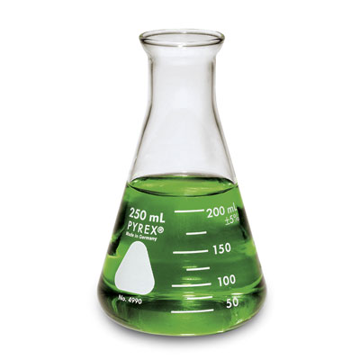
Application
Students use appropriate concepts and procedures for application without prompting.
Teachers provide opportunities to apply math concepts in “real world” situations.
Use grade appropriate math in all content areas.

Slide 42
Standards for Mathematical Practice
Establish habits of mind
Procedural fluency
Development of concepts
Application of knowledge
Self-assessment

Slide 43
Mathematical Practice Standard 1
Problem Solving Strategies
Create Drawings
Look for patterns
Work backwards
Consider a simpler case
Estimate solution
Make a table, chart or list
Make sense of problems and persevere in solving them.
Gather Information
Make a Plan
Anticipate possible solutions
Continuously evaluate process
Check results
Question sense of solutions
Notes:
Mathematically Proficient Students:
Explain the meaning of the problem to themselves
Look for a way to start and note the strategies that will help solve the problem.
Identify and analyze givens, constraints, relationships and goals
Make inferences about the form and meaning of the solution
Design a plan to solve the problem
Use effective problem solving strategies
Evaluate the progress and change the strategy if necessary
Solve the problem using a different method and compare solutions
Ask, “Does this make sense?”

Slide 44
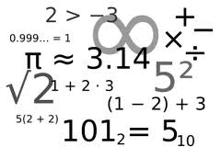
Mathematical Practice Standard 2 | Reason abstractly and quantitatively.
Decontextualize
Represent a situation symbolically and manipulate the symbols
99 ÷ 44 = 2.25
Sample Problem
99 students need to go on a field trip. The busses can carry 44 students each. How many busses do they need?
Mathematical Problem
Will need 3 busses.
Contextualize
Make meaning of the symbols in the problem
Notes:
Mathematically proficient students:
•Make sense of quantities and their relationships in problem solutions.
•Use two complementary abilities when solving problems involving number relationships.
Decontextualize-be able to reason abstractly and represent a situation symbolically and manipulate the symbols
Contextualize- Make meaning of the symbols in the problem
•Understand the meaning of quantities and are flexible in the use of operations and their properties.
•Create a logical representation of the problem
•Attends to the meaning of quantities, not just how to compute them.

Slide 45
Square Peg in a Round Hole
Stacey drilled a 18 cm hole into a piece of wood.
What are the dimensions of the cube that that can drop into this hole where the vertices of the cube touch the circle?
Diameter= 18cm
David Hebert
Nuiqsut Trapper School

Slide 46
Mathematical Practice Standard 3 | Construct viable arguments and critique the reasoning of others.
Use assumptions, definitions and previous results
Create an argument
Make a conjecture
Build a logical progression of statements to explore conjecture
Analyze the situations by breaking them into cases
Recognize and use counter examples
Critique an argument
Support an argument
Distinguish correct logic
Communicate conclusions
Explain flaws
Justify conclusions
Ask clarifying questions
Respond to arguments
Notes:
Mathematically proficient students:
•Analyze problems and used stated mathematical assumptions, definitions, and established results in constructing arguments.
•Justify conclusions with mathematical ideas
•Listen to arguments of others and ask useful questions to determine if an argument makes sense.
•Ask clarifying questions or suggest ideas to improve/revise the argument.
•Compare two arguments and determine correct or flawed logic.

Slide 47
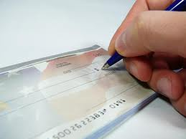
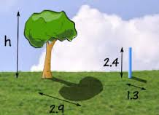
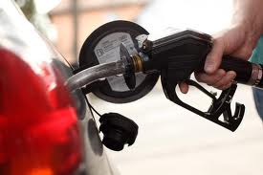
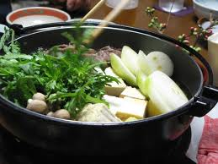
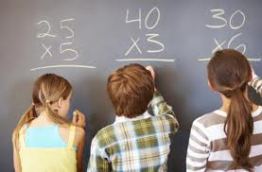
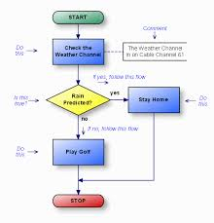
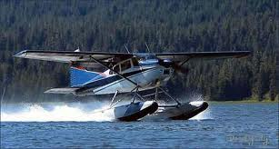
Mathematical Practice Standard 4 | Model with mathematics.
Everyday situations
…reasoned using mathematical methods
Notes:
Mathematically proficient students:
•Understand this is a way to reason quantitatively and abstractly (able to decontextualize and contextualize).
•Apply the math they know to solve problems in everyday life.
•Are able to simplify a complex problem and identify important quantities to look at relationships.
•Represent mathematics to describe a situation either with an equation or a diagram and interpret the results of a mathematical situation.
•Reflect on whether the results make sense possibly improving/revising the model.
•Ask, “ How can I represent this mathematically?”

Slide 48
35 feet
4 feet
Walkway
40 feet
The administration found that students liked to take a shortcut across the 35 ft. by 40 ft. grassy field. They decided to put in a 4 ft. wide walkway.
30 feet
Determine the area of the walkway.

Slide 49
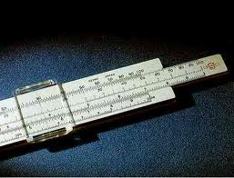
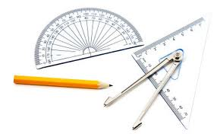
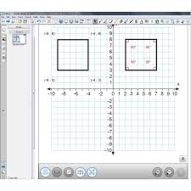
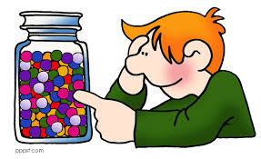
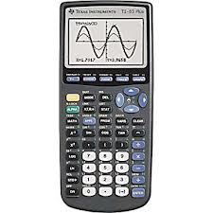
Mathematical Practice Standard 5 | Use appropriate tools strategically.
Use available tools.
Strengths?
Weaknesses?
Estimate
Use technological tools.
Notes:
Mathematically proficient students:
Use available tools recognizing the strengths and limitations of each.
Use estimation and other mathematical knowledge to detect possible errors.
Identify relevant external mathematical resources to pose and solve problems.
Use technological tools to deepen their understanding of mathematics.

Slide 50
Mathematical Practice Standard 6 | Attend to precision.
Precision
Communication
Calculations
Symbols and labels
Precision in solutions
Explain results and reasoning
Significant figures
Accuracy and efficiency
∏ ∑ √
cm² m/sec
Notes:
Mathematically proficient students:
•Communicate precisely with others and try to use clear mathematical language when discussing their reasoning.
•Understand meanings of symbols used in mathematics and can label quantities appropriately.
•Express numerical answers with a degree of precision appropriate for the problem context.
•Calculate efficiently and accurately.

Slide 51
Hexagon Perimeters
Look at the hexagons. As each hexagon is added, the perimeter of the whole figure changes.
What will the perimeter be after the 10th hexagon is added?
What will the perimeter be after the 100th hexagon is added?
How could you determine the perimeter of any number of hexagons you had in the figure?

Slide 52
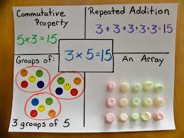
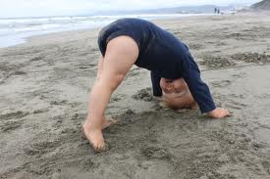
Mathematical Practice Standard 7 | Look for and make use of structure.
Patterns
See complicated things as a single object or as being composed of several objects.
Shift Perspective
Notes:
Mathematically proficient students:
•Apply general mathematical rules to specific situations.
•Look for overall structure and patterns in mathematics.
•See complicated things as single object or as being composed of several objects.
•Be able to look at problems from a different perspective.

Slide 53
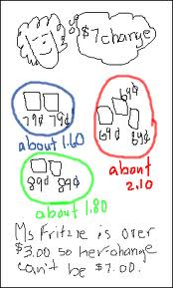
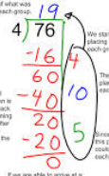
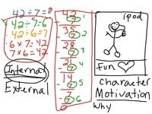
Mathematical Practice Standard 8 | Look for and express regularity in repeated reasoning.
See repeated calculations and look for generalizations
Recognize reasonable solutions
See the process – attend to details
Understand the broader application of patterns
Notes:
Mathematically proficient students:
•See repeated calculations and look for generalizations and shortcuts.
•See the overall process of the problem and still attend to details.
•Understand the broader application of patterns and see the structure in similar situations.
•Continually evaluate the reasonableness of their intermediate results.

Slide 54
Mathematics Standards
Understanding
Notes:
A deep understanding of mathematical concepts occurs where the content standards (the what) and the mathematical practices (the how) intersect.

Slide 55
Performance Tasks
Demonstrate mastery
Organized approach using multiple strategies
Fosters self-checking
Explanation of mathematical reasoning
Utilizes Mathematical Practices
http://insidemathematics.org/index.php/exemplary-lessons-integrating-practice-standards
Notes:
Activities that give students the opportunity to demonstrate their understanding and mastery of math skills and concepts covered in class.
Students
Use an organized approach using one or more strategies
Explain the steps and strategies used to complete the task
Show evidence of checking answers for correctness and reasonableness.
The tasks require analysis to explain the methods used and the reasoning behind choosing the method.

Slide 56
Odd Numbers
Kate makes a pattern of squares.
1 x 1
She starts with one square,
then adds three more, then five more,
and so on.
2 x 2
3 x 3
Draw the next shape in her pattern.
How many new squares did she add?
What size square did you make?
Notes:
Have the participants do the Odd Numbers performance task (2 slides) working in pairs.

Slide 57
The total number of squares makes a number pattern.
1 = 1 x 1 = 1
1 +3 = 2 x 2 = 4
1 + 3 + 5 = 3 x 3 = 9
4. Write the next two lines of the number pattern.
5. Use the number pattern to find the total number of
these numbers.
1 + 3 + 5 + 7 + 9 + 11 + 13 + 15 + 17 + 19 =_________
Write down the number pattern that gives a total of 169. Explain your work.
Notes:
This is an example of a performance task that guides students through a process. There is room for open ended thinking and conversation within the structure of the task.
This would be a good example of how a teacher could introduce performance tasks.

Slide 58
A local food company produces yogurt in 3/4 cup containers.
2 cups = 1 pint
2 pints = 1 quart
4 quarts = 1 gallon
16 fl oz = 1 pint
The tubs of yogurt are sold for 75¢ each. Twenty percent of this is profit for the food company. How much profit does the company make on each tub?
The machine that fills the ¾ cup tubs with yogurt runs 10 hours a day for 5 days a week. It fills 1600 tubs an hour. How many gallons of yogurt are needed to fill 1600 tubs?
How many gallons of yogurt are produced each week?
What is the percent increase in production if the machine runs for 7 days a week instead of 5 days a week?
http://www.achieve.org/ccss-cte-classroom-tasks

Slide 59
Searching for Standards
Overview of High School Content Standards
Alaska Mathematics Standards document (p. 92)

Slide 60
ETT and Wilderness First Aid

Slide 61
ETT and Wilderness First Aid

Slide 62
Searching for Standards
Brief Description of Alaska Mathematics Standards
Conference Handouts on LiveBinders

Slide 63
Scholastic’s Math@Work is a web series that ties students’ classroom learning to their career aspirations.
http://teacher.scholastic.com/products/mathematics/

Slide 64
Don’t Forget the Mathematical Practices
Natural fit with the Career Ready Practices
Look for connections

Slide 65
Contact Us
Deborah Riddle
Math Content Specialist
deborah.riddle@alaska.gov
907-465-3758

