Slide 1
2013 Providers Conference Alaska English/Language Arts
Karen Melin
Alaska Department of Education & Early Development
Administrator of Instructional Support
907-465-6536
karen.melin@alaska.gov

Slide 2
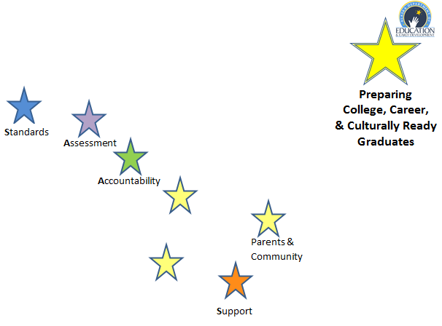

Slide 3
Goals For This Session
Gain a greater cognitive understand the key shifts in the Alaska English/Language Arts and their implications to instruction.

Slide 4
Poll
http://www.polleverywhere.com/multiple_choice_polls/MoYC3Bggbi02hem

Slide 5
Foundational Skills

Slide 6
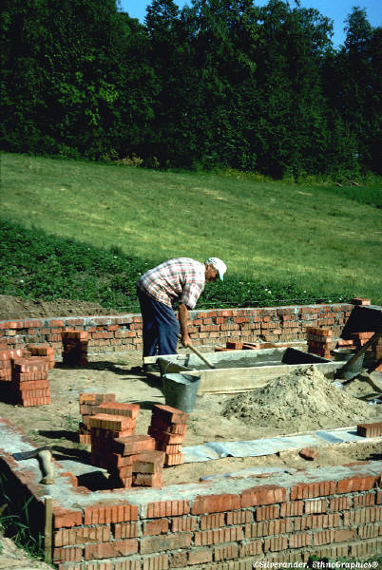
Foundational Skills
Print Concepts (K – 1)
Phonological Awareness (K – 1)
Phonics and Word Recognition (K – 5)
Fluency (K – 5)

Slide 7
General Shifts in Instruction
Building knowledge through content-rich nonfiction and information texts in addition to literature
2. Reading and writing grounded in evidence from the text
3. Regular practice with complex text and its academic vocabulary
Notes:
The new standards represent a shift in the way we approach instruction. The three major shifts in the ELA standards are:
Building knowledge through content-rich nonfiction and information texts in addition to literature
Reading and writing grounded in evidence from the text
Regular practice with complex text and its academic vocabulary
Now we will take a look and some of the more specific details within each content area.

Slide 8
Shift #1: Building Knowledge Through Content-Rich Nonfiction and Informational Text

Slide 9
What is Informational or Content-Rich Nonfiction Text in ELA ?
Literary nonfiction. For purposes of Alaska ELA Standards,
Biographies, memoirs, speeches, opinion pieces
Essays about art, literature, journalism, etc.
Historical , scientific, technical, or economic accounts written for a broad audience
Emphasis is on text structure other than narrative
Historical text (Gettysburg Address, Letters from the Birmingham Jail, or The Preamble and First Amendment of the United States Constitution)

Slide 10
Shift #2: Reading and Writing grounded in Evidence From Text

Slide 11
What does that mean?
For reading, students must grasp information, arguments, ideas and details based on careful attention to the text.
For writing, students must write to present analyses, well-defended claims, and clear thoughts using textual evidence.
Teachers become masterful at using text-dependent questions to help students achieve these objectives.
Notes:
The first shift in ELA/Literacy is to build knowledge through content-rich nonfiction. Think of the two parts of this statement– first, we are building knowledge from text. Students use the text as a source of knowledge. This of course means that in addition to reading stories, students are reading nonfiction. The Alaska Standards require that in elementary school about half of what students read should be fiction and about half of what they read should be nonfiction. In order for these texts to support the building of knowledge, students should read a coherent set of texts that actually support the building of knowledge through text. This is different from what is typically happening in classrooms now. Currently as much as 80% of what students read is fiction and when they do read nonfiction, it is often as an isolated “experience in reading nonfiction” such as in a weekly news magazine. These texts don’t build knowledge through a series of nonfiction texts and they rely on a great deal of knowledge outside of the text. In middle and high schools the standards require attention to literacy across the content areas. This means that science teachers and social studies support student literacy as a way to enhance knowledge and skills in the content area. There are standards included that specifically describe these expectations. They are an important component - not a suggestion for implementation, not an appendix, but an essential part. In looking at a student’s reading requirements across the school year, across all classes middle and high school students should be reading about 70% nonfiction and 30% fiction. When the content areas are on board, this means that the English class still focuses on literature with some addition of nonfiction.

Slide 12
Shift #3: Regular Practice With Complex Text and Its Academic Vocabulary
Notes:
Facilitator Talking Points :
The third shift requires that ALL students have regular practice with grade level appropriate complex text and its academic language (vocabulary and syntax)
Just as evidence appears all over the ELA standards, so does complex text. It is the first half of Standard Ten, the same standard that calls for a range of text types. It is a standard for students to read grade appropriate complex text at every point in school.
Vocabulary is central to the standards as well. It is what Reading Standard 4 is about, and is also the focus of Language Standards 4,5, and 6.

Slide 13
What does that mean?
All student have the opportunity to practice reading complex text
Text is strategically chosen to help students become confident when confronted with text that is complex in structure, vocabulary, and/or density of information. Does not have to be non fiction to be complex.
An emphasis on building content vocabulary as well as academic vocabulary (words found commonly in academic settings like: analysis, assessment, establish, identify, and determine)
Notes:
Complex text contains any and all combinations of these features in many combinations.
The complexity level is determined by both quantitative and qualitative measures. The details of text complexity are well described in Appendix A of the Standards, one of the supplemental readings offered with this module. New tools have been developed since the Standards were developed to help determine qualitative text complexity. Those materials are available on www.achievethecore.org
Students who struggle with reading almost always have gaps in their vocabulary and their ability to deal with more complex sentence structures. This too is well documented in research.
Too often, less proficient students are given texts at their level where they do not see these features, where the demands of vocabulary and sentence structure are lowered. Though this is done for the kindest of reasons, it has disastrous consequences. Day by day, differentiating by level of text during instructional time increases the achievement gap between high performers and those who struggle.
Students cannot address gaps in their vocabulary and develop skill with unpacking complex syntax text when they are not given the opportunity to work with material that provides these opportunities.
With that said, there is a place for providing students with text more appropriately matched to their individual reading abilities to build fluency and provide opportunity for increasing the volume of reading. But those texts cannot be the primary texts for instruction.

Slide 14
Complex Text Scaffolding…
There are many ways to scaffold student learning in complex text:
Multiple reads using annotation
Read Aloud
Chunking text (a little at a time)
Provide support while reading, rather than before
Notes:
Students who struggle with reading almost always have gaps in their vocabulary and their ability to deal with more complex sentence structures. This too is well documented in research.
Too often, less proficient students are given texts at their level where they do not see these features, where the demands of vocabulary and sentence structure are lowered. Though this is done for the kindest of reasons, it has disastrous consequences. Day by day, differentiating by level of text during instructional time increases the achievement gap between high performers and those who struggle.
Students cannot address gaps in their vocabulary and develop the skill of unpacking complex syntax when they are not given the opportunity to work with materials that provides those opportunities.
With that said, there is a place for providing students with text more appropriately matched to their individual reading abilities in order to build fluency and provide opportunity for increasing the volume of reading. But those texts cannot be the primary texts for instruction.
This does not mean students do this without any support! It is essential that teachers and instructional material provide scaffolds to support ALL students in comprehending complex text.
These scaffolding types will reliably support many students and a has a strong research base:
Multiple readings. Complex text takes multiple reads to fully understand the layers of meaning provided by the author. Because of this, the text selected for close reading should be excellent or they will not be worthy of the time commitment they require to read fully. Re-reading assists fluency and is the primary way readers make sense of challenges encountered when reading.
Reading the text aloud while students follow along . Fluency challenges are rampant when students encounter grade level appropriate text. All teachers must be aware of this and reach in to help. The two best ways to help are having the students follow along while the text is read aloud and by reading text multiple times. (These two methods are systematically built into the close reading model included in this module.)
Read aloud of complex text is especially important for early readers K-2 because the work of the standards is too complex to apply to the texts students can read on their own, and students cannot develop academic language through the texts students can read on their own at these grades (levels); for all practical purposes read aloud provides students who come to kindergarten with less developed academic language with a way to catch up.
“Chunking” longer text into smaller and logical sections makes the text more manageable and helps demonstrate how the author structured the text.
Careful, text-specific questions point readers to challenging sentences and ask for special attention to be paid to them. They direct students to what matters most and asks them to examine those parts. They also pay particularly close attention to vocabulary that can be figured out in the context of the text. Because they require text evidence, they demand re-reading.
Pointing out text structures or features that will either provide comprehension support (like section headers) or challenges (like long paragraphs or sentences).
Supports that do not promote improved reading incomes and do not have research support behind them:
Previewing the topic of the reading in a text-free way (just “teacher talk”). A careful examination of the text is solid practice. But telling students what they will be reading before they read will remove any motivation for discovering it for themselves and it will teach students that learning from reading is not a central activity in that classroom.
Providing simple text to weak readers and complex texts to strong readers. Differentiation by text type, as opposed to providing a variety of supports for the same complex text, leads to the “Matthew Effect” – “to those who have, more will be given. To those who have little, even that little will be taken away,” a well-researched finding. This is particularly true because of the differences in vocabulary that students will see from simpler to more complex text. Words create much of the differences in texts.
The goal is growing independence with increasingly complex text. The strategies implemented should all aim at getting students stronger and more skilled – like exercises and scrimmages in a sports practice.

Slide 15
Academic Vocabulary?
Content Vocabulary
Carnivore
Erosion
Refraction
Tariff
Migration
Region
Academic Vocabulary
Organized
Analysis
Compare
Contrast
Outline
Synthesis

Slide 16
Look at high yield instructional strategies for shifting to the new standards

Slide 17
Explicit Instruction on text structures
Narrative
Informational
Character(s)
Cause/Effect
Setting
Compare/Contrast
Problem/Conflict
Description
Events
Chronology/Sequence
Resolution/Outcomes
Theme
Problem/Solution
Notes:
Explain that there are more types. These are appropriate for K-3.

Slide 18
Close Reading
Close reading is meant to be completed using short texts at grade level.
Close reading is meant to be completed over several repeated readings extended over several teaching periods.
Close reading is meant to be a collaborative process amongst peers and facilitated by an educator

Slide 19
VOCABULARY

Slide 20
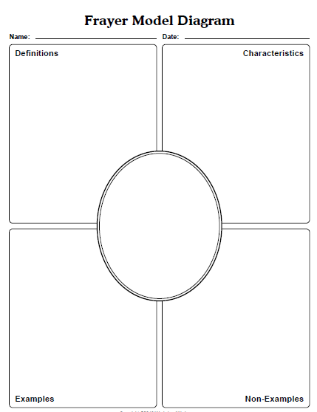
Vocabulary
Better understanding of complex words
Promotes critical thinking
Draws on prior knowledge to build new connections
Accommodates different learning styles
What the word is
What the word is not
Visual reference

Slide 21
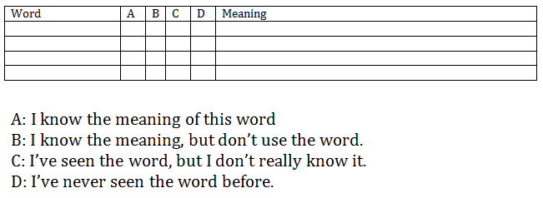
Activity: Vocabulary
Survival Words
Choose several unfamiliar words from the text.
Have students copy the chart.
Students write the meaning of the words they know.
Work in groups to share words that they are most confident about.
Review charts with the entire class and help them clarify words which they still have difficulty.

Slide 22
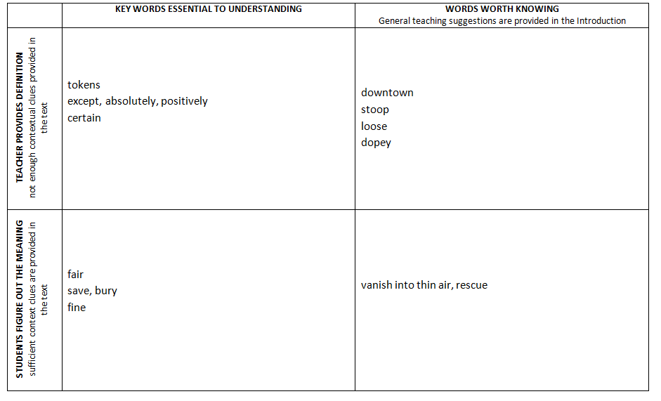
VOCABULARY
Notes:
From Alexander Who used to be Rich last Sunday

Slide 23
Video
https://www.teachingchannel.org/videos/strategy-to-build-student-vocabulary?utm_campaign=digest&utm_medium=email&utm_source=digest

Slide 24
Asking the right questions takes as much skill as giving the right answers.
Robert Half

Slide 25
Progression of Text Dependent Questions
Opinions, Arguments, Intertextual Connections
Inferences
Author’s Purpose
Vocab & Text Structure
Key Details
General Understanding
Notes:
General Understanding Questions:
Students grasp the overall view of the text
Global questions that require students to demonstrate that they understand what the author really said
Questions may look at sequences in the text, look at the main idea and the text that supports it, or ask the students to provide the gist of the passage.
Key Details questions:
Students focus on the details
Who, what, why, when, where, how questions
Find supporting details for main ideas
Look for nuances in meaning
Vocabulary and Text Structure questions:
Focus on specific words and phrases
Focus on structure of the text
Note denotation, connotation, figurative language
Examine the shades of meaning that comes with careful word choice
Notice that text organization influences and contributes to meaning
Author’s Purpose questions:
Question the genre and how that influences meaning
Did the text entertain, inform or persuade?
How the author constructed the text gives clues to the purpose (i.e., point of view)
Inferences questions:
Probe each argument in persuasive text, each idea in informational text, each key detail in literary text
Students consider the information and create “informed extrapolations from the information provided”
Opinions, Arguments, Intertextual Connections questions:
Generate lively discussions when the discussions are built from text dependent questions
Tie to personal connections
Encourage the use of logic to answer the questions using the text as evidence
Sources:
Fisher, D., & Frey, N. (2008, Jan). Engaging the adolescent learner: Text complexity and close reading. Retrieved from http://www.reading.org/Libraries/members-only/Fisher_and_Frey_-_Text_Complexity_-_January_2012.pdf

Slide 26
Text Dependent Questions
Can only be answered with evidence from the text.
Can be literal and will involve higher level thinking skills (analysis, synthesis and evaluation).
Focus on vocabulary, sentence and paragraph, in addition to larger ideas, themes or events.
Focus on the challenging sections of the passage.
Include prompts for writing and discussion.
Three types of questions
Assess theme and central ideas
Assess knowledge of vocabulary
Assess syntax and structure
Notes:
We often ask students simple recall questions that require very literal thinking to ensure they have read the text.
Students spend too much time and energy answering these questions rather than slowing down to consider the meaningful text-specific questions that will bring them to a deeper understanding.
Asking students to make connections to themselves, other text and the world is a common style of questioning that guide students away from the text. This type of questioning does not lead to a deep understanding of the text.
A shift to text dependent questions
Allows more instructional time in the text
Puts students on an even playing field- not all students will have the same background knowledge or experiences to draw from. The text will provide all students with the same information to work with.
The focus is placed on the text for classroom discussions instead of personal experiences on the topic.
Text dependent questions
Allow students to infer
Do not depend on additional outside information
Allow students to gather evidence and build knowledge
Allows access to increasing levels of complex text
Requires teachers to be thoughtful in preparation of questions and choice of text
Requires more time for students to process
Can include prompts for discussion and writing activities
Questions that use higher level thinking skills (analysis, synthesis and evaluation) point to the difficult parts of the text.
Text dependent questions drive literacy/comprehension progress in the classroom if the questions center around the words, sentences, paragraphs, big ideas, themes relationships, etc.
Text dependent questions provide the students to work with tier two (academic) vocabulary and syntax that are features of complex text- the features that make text difficult for students.
Good questions make students stronger and more capable readers.

Slide 27
Creating Text Dependent Questions
Step One: | Identify the core understandings and key ideas of the text.
Step Two: | Start small to build confidence.
Step Three: | Target vocabulary and text structure.
Step Four: | Tackle tough sections head-on.
Step Five: | Create coherent sequences of text-dependent questions.
Step Six: | Identify the standards that are being addressed.
Step Seven: | Create the culminating assessment.

Slide 31
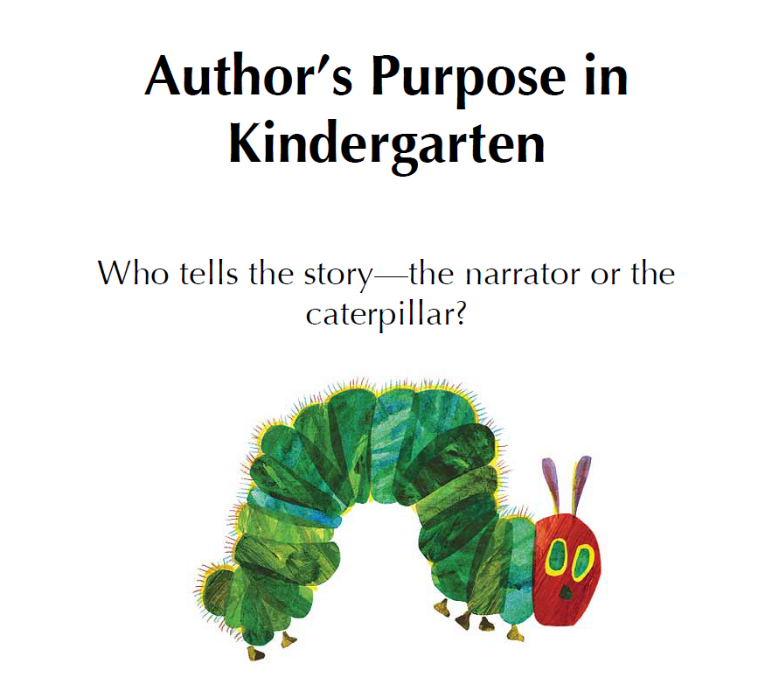

Slide 33
www.fisherandfrey.com

Slide 34
Your turn
Develop three text dependent questions that focus on the following areas:
Theme and Central Ideas
Knowledge and Vocabulary
Syntax and Structure

Slide 35
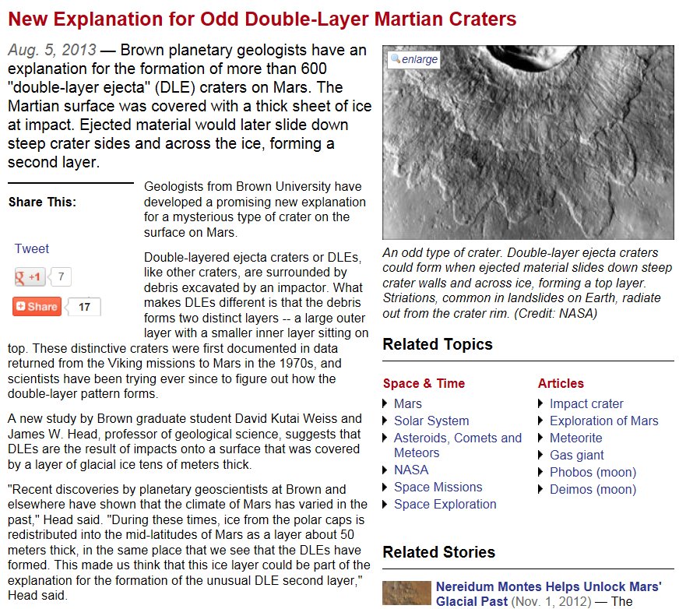
Brown University (2013, August 5). New explanation for odd double-layer Martian craters

Slide 36
Text Dependent Questions
Theme and Central Ideas
What evidence supports varied climate as a possible cause for double-layered craters on Mars?
Knowledge and Vocabulary
Impact (verb) means to strike forcefully. An impactor (noun) is something that strikes something else forcefully. What happened on Mars when its surface was struck by an impactor?
Syntax and Structure
An appositive is a noun or pronoun which adds extra information to clarify a noun in the sentence. Watching for the commas that surround the appositive, determine what James W. Head does at the University.

Slide 37
Goals For This Session
Gain a greater cognitive understand the key shifts in the Alaska English/Language Arts and their implications to instruction.

Slide 38
Closing

Slide 39
Contact Me!
Karen Melin, Administrator of Instructional Support
karen.melin@alaska.gov, 907-465-6536
Notes:
Here are key contacts for the new Alaska Standards.

