Slide 1

Uploading Enrollment Files into the State Report Manager (SRM)
National School Lunch Program (NSLP) Annual Training
August 10, 2017
Brian Laurent, Data Management Supervisor
Alaska Department of Education & Early Development

Slide 2
Introduction
Brian Laurent
Data Management Supervisor
Has been with DEED since September 2013
Our team’s responsibilities:
  Produce school accountability measures
  Required federal and state reporting
  Quality control of assessment data
  Reporting of teacher and other staff data
  Administration of data collections

Slide 3

Today’s agenda
Purpose of the data collection
Where to find what you need
The file layout
The State Report Manager (SRM)
Recommended upload dates
File automation
Contact information

Slide 4
Purpose of the data collection
Transfer enrollment information into the PrimeroEdge database system provided for school nutrition use
Benefits of PrimeroEdge include:
  Online income-eligibility application
  DEED can securely distribute monthly lists of students eligible for free meals
  Online benefit issuance document

Slide 5
Where to find what you need
Forms & Grants page of DEED’s website
  https://education.alaska.gov/forms/
  Scroll down to “Child Nutrition Programs – Enrollment Data Collection”
The handbook for the 2017-2018 school year is now available, as well as the column header template
  No changes to the template

Slide 6
The file layout
Required data elements
Optional data elements
AKSID
Last name
First name
Birth date
School number
District student ID
Middle name
Name suffix
Gender
Race/ethnicity
Grade level
Address
Notes

Slide 7
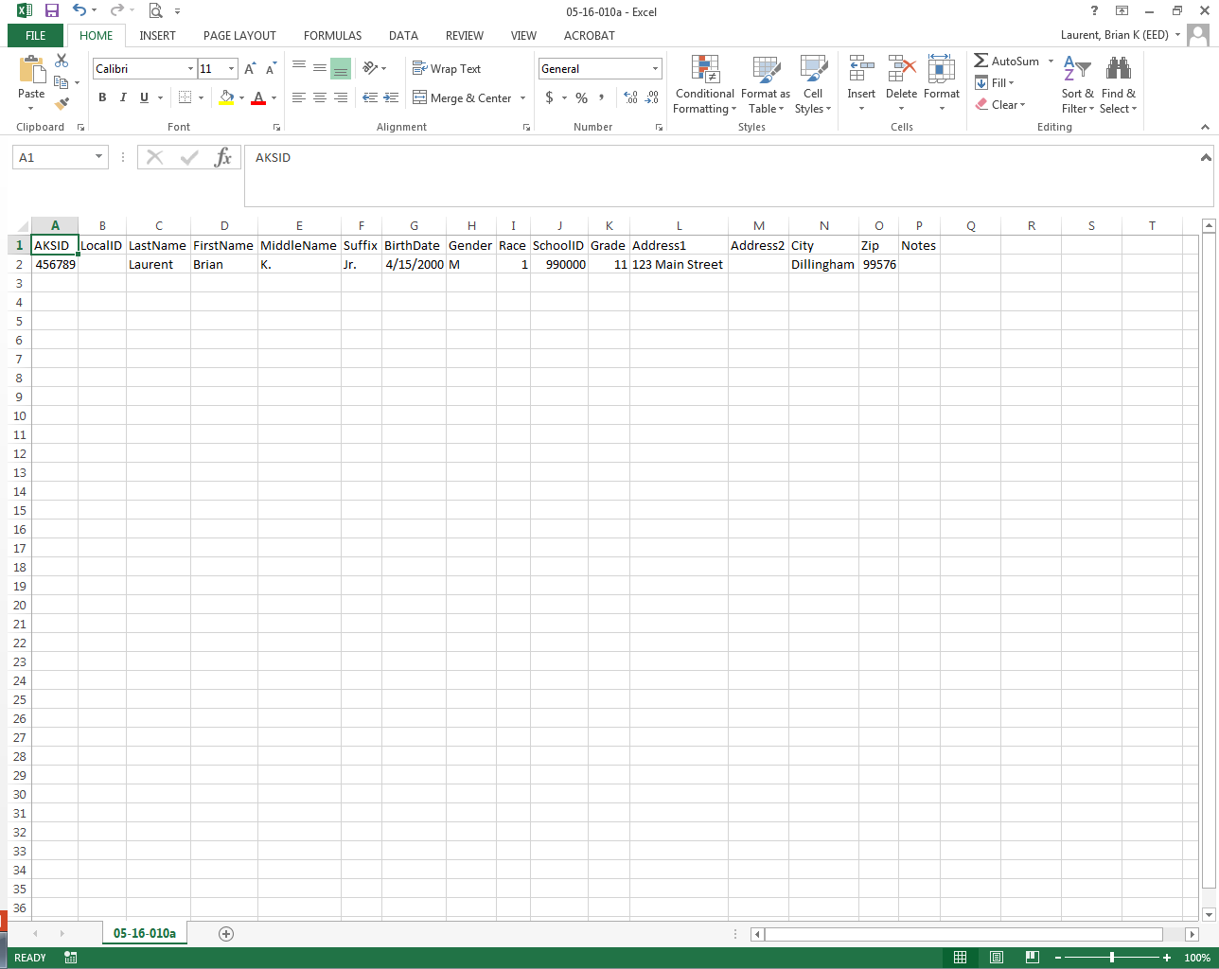

Slide 8
A few notes about the data elements
Race/ethnicity
  If student is Hispanic and anything else, code as Hispanic
  If student is multiracial and not Hispanic, code as Two or More Races
School ID
  The list of valid school IDs is found at https://education.alaska.gov/Alaskan_Schools/Public/DistrictandSchoolIDs.pdf

Slide 9
The State Report Manager (SRM)
The SRM allows for secure file transmissions to DEED
The SRM also has quality control checks
  Errors vs. warnings
Specific instructions are found on pp. 12-15 of the handbook (Appendix D)
For an SRM account, please contact Tim Workman (465-8579, tim.workman@alaska.gov)

Slide 10
Recommended upload dates
At the beginning of the school year
On or before October 1 of each fall
When new students enroll
When existing students transfer to new districts
On or before April 1 of each spring

Slide 11
File automation
Unlike other data collections in the SRM, districts upload multiple Child Nutrition enrollment files throughout the year
DEED received a request to automate these uploads
A process has been successfully implemented to automate file uploads directly from a district’s student information system (SIS)

Slide 12
File automation – project timeline
Piloted automation in early 2016-2017 with a SchoolMaster district
Piloted with a PowerSchool district
Broader rollout to a group of PowerSchool districts
DEED is now able to extend this opportunity to all districts

Slide 13
Final notes
Enrollment information is transferred from the SRM to PrimeroEdge every 30 minutes during the workday
If you notice that PrimeroEdge does not reflect the information from your most recent SRM upload, contact Brian, Jo, or Beth

Slide 14
Contact information
SRM technical contact
Brian Laurent, Data Management Supervisor
  brian.laurent@alaska.gov, 465-8418
Program contacts
Jo Dawson, Child Nutrition Program Manager
  jo.dawson@alaska.gov, 465-8708
Beth Seitz, NSLP Coordinator
  elizabeth.seitz@alaska.gov, 465-8709

