Slide 1
Point of Service & Counting and Claiming
Alaska Child Nutrition Program

Slide 2
Overview
Part I – Elements of Acceptable Point of Service Counting & Claiming Systems
Part II – Examples of Meal Counting & Claiming Systems
Part III – Unacceptable Meal Counting & Claiming Systems
Notes:
Overview:
Part I – Elements of Acceptable Point of Service Counting & Claiming Systems
Part II – Examples of Meal Counting & Claiming Systems
Part III – Unacceptable Meal Counting & Claiming Systems

Slide 3
Part I: Elements of Acceptable Point of Service Counting & Claiming Systems
Eligibility Documentation
Collection Procedures
Point of Services Meal Counts
Daily Lunch Counts
Internal Controls
Claim for Reimbursements
Notes:
Part I: Elements of Acceptable Point of Service (POS) Counting & Claiming Systems
Eligibility Documentation
Collection Procedures
Point of Services Meal Counts
Daily Lunch Counts
Internal Controls
Claim for Reimbursement

Slide 4
POINT OF SERVICE
Acceptable Counting System at the Point of Service
That point at which you can determine the student has a reimbursable meal.
Salad Bars point of service may be after the POS, but must have monitoring to be sure each student selects there other components.
Note: Offer vs. Serve - lunch is reimbursable with 3 components of the required meal pattern.
Notes:
What are Acceptable Counting System at the Point of Service
An acceptable point of service is that point at which you can determine if the student has a reimbursable meal or at the end of the serving line.
Salad Bars point of service may be after the POS, but must have monitoring to be sure each student selects there other components.
Please Note: Offer vs. Serve is required for the high school age/grade group and a student may decline up to two of the meal components, a reimbursable meal may have only 3 meal components, however one of those components must be at least a ½ cup serving from the fruit or vegetable group.

Slide 5
Point of Service Meal Counts
That point at which you can determine the student has a complete reimbursable meal.
Count :
Reimbursable meals
By category
Each day
Without overt identification
Notes:
What is an acceptable point of service meal count? That point at which you can determine if the student has a complete reimbursable meal. A complete reimbursable meal consist of the five food components (i.e. meat/meat alternate, fruit, vegetable, bread/grain, and milk)
Note: Offer vs. Serve - a student may decline 2 of the 5 food components, however one of those 3 components must be from the fruit or vegetable group to have a reimbursable meal.
How to Count:
Reimbursable meals – Make sure each student has select all of the required meal components for a reimbursable meal
By category – Make sure the counting system can count meals by category for each student
Each day – Meal counts must be done each day
Lastly counting meals must be done without overt identification

Slide 6
Daily meal counting systems
Acceptable meal counting systems:
Class Roster Check List
School Roster Check List
Ticket System
Cash Register Code System
Prepaid List
Computerized Bar Code I.D. Cards
Remember:
keep application on file for each student claimed free or reduced
Free and Reduced meal count must match student count
Notes:
What are Acceptable meal counting systems?:
Class Roster Check List
School Roster Check List
Ticket System
Cash Register Code System
Prepaid List
Computerized Bar Code I.D. Cards
Remember:
You must keep applications on file for each student claimed free or reduced and
Free and Reduced meal count must match the number of student count
Reports may be referred to as “ daily records of operations”, “daily/weekly food service reports”, “daily report of participation”, ect…

Slide 7
ROSTER SYSTEM AT THE POINT OF SERVICE
The roster or checklist:
Use to determine the number of reimbursable meals served in each category.
must include the names or numbers of students in each category (free, reduced, & paid).
Notes:
One type of system for counting is the roster or checklist:
These may be used to determine the number of reimbursable meals served in each category. And
They must include the names or numbers of students in each category (free, reduced, & paid).

Slide 8
ROSTER SYSTEM AT THE POINT OF SERVICE :
Name Checklist
list of all children’s names
check marked by the student’s name when they have collected a reimbursable meal
compared with the master list of names or coded by category
Class List
teacher or designated person marks off each child’s name as served a reimbursable meal.
list given to person responsible for recording meal and or/milk counts and matched by student and category.
Notes:
Other roster or checklist systems that may be used are Name Checklist and Class list:
A Name Checklist
Is a list of all children’s names
Check marked by the student’s name when they have collected a reimbursable meal
Compared with the master list of names or coded by category once the meal service is complete
A Class List
A teacher or designated person marks off each child’s name as they are served or select a reimbursable meal. Then the list is given to the person responsible for recording meals and or/milk counts and matches them by student and category.

Slide 9
CHECKLIST SYSTEMS
TAKING COUNTS:
Total Meals claimed for Monday is 13.
Total Meals claimed for the Week of October 16, 2009 is 62.
Daily count cannot be more than 14.
Roster saved for 3 years plus the current year to be available for a CRE or audit.
Notes:
Here is an example of a class checklist system.

Slide 10
Other checklist systems:
Number Checklist - student has identification number.
Number given to the person with the checklist who puts a mark by the student’s number on the check-list when they take a reimbursable meal.
Remember, the method must also prevent “overt identification”
Notes:
Other forms of checklist may include:
Number Checklist – this type of system a student has an identification number. The number is given to the person with the checklist who puts a mark by the student’s number on the check-list when they take a reimbursable meal.
Remember any system used must always prevent “overt identification”

Slide 11
Electronic Point of Service systems:
Point of Service (POS) options:
Single line or Multiple line
Touch-Screen, ordinary PC, or serving terminal
Notes:
software for meal counting and claiming.

Slide 12
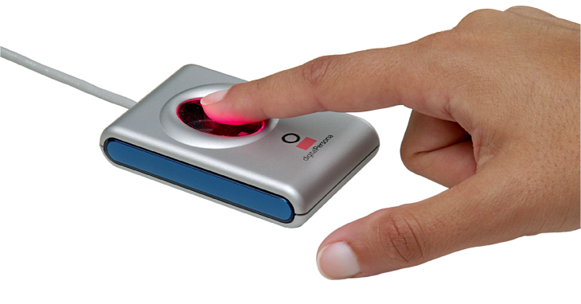
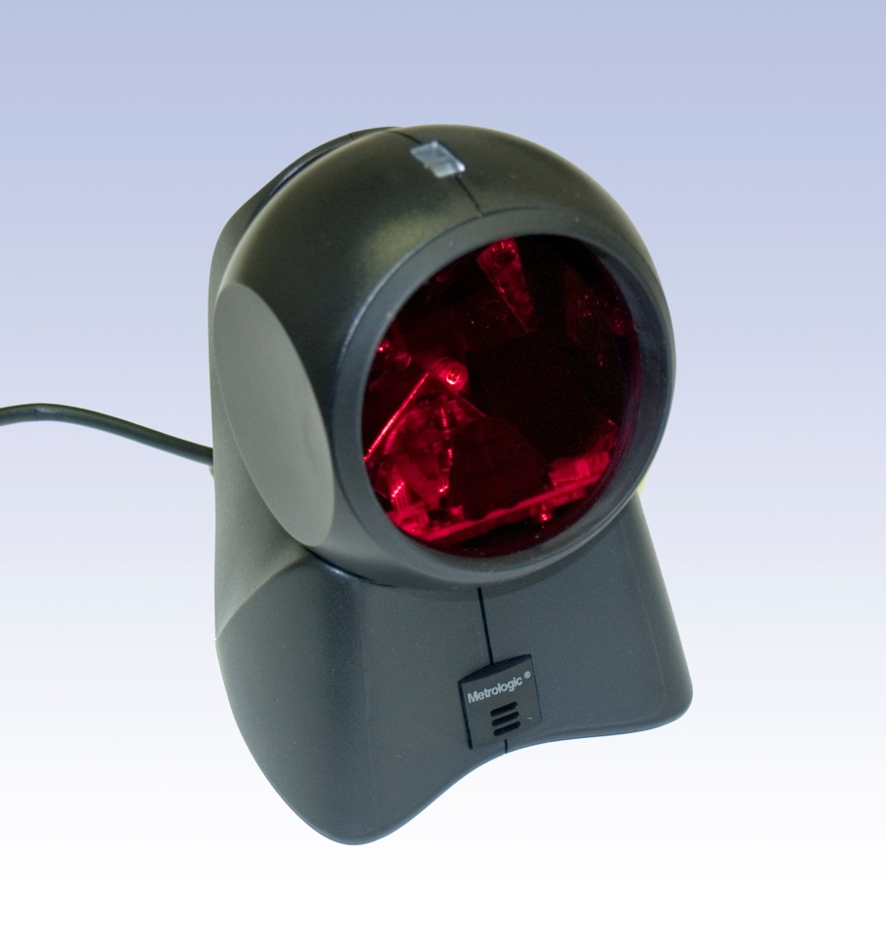
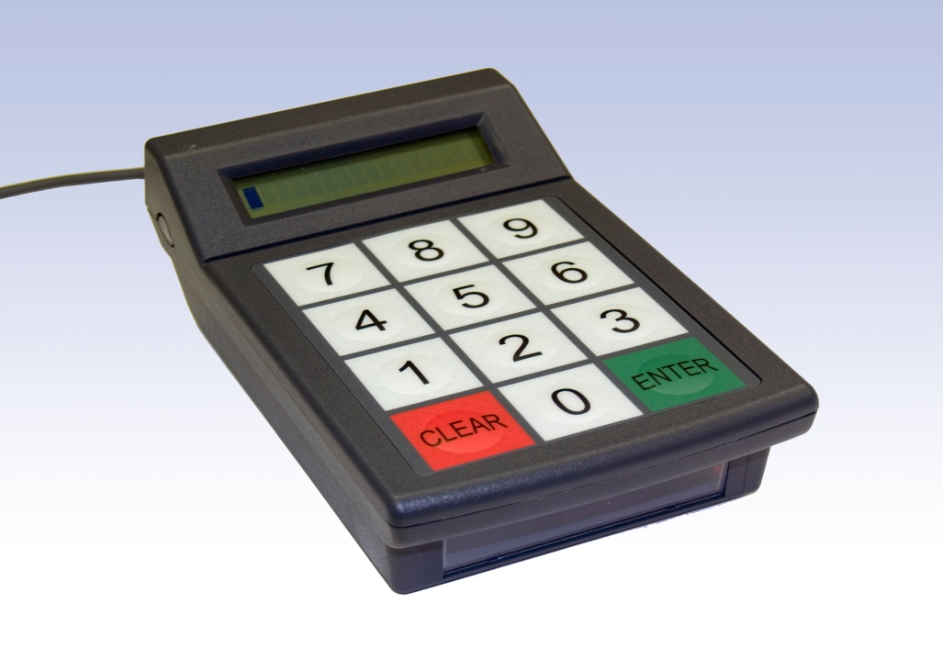
POS Input Device Options
Countertop barcode reader
Fingerprint reader
Keypad/barcode reader
Notes:
Electronic POS systems
Bar code scanners, Keypads to enter students id’s.

Slide 13
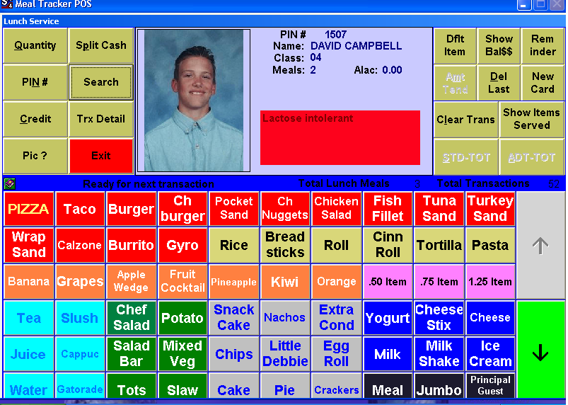
Site POS Example Screen
Notes:
Sample screen shot of a POS system.

Slide 14
Acceptable or Unacceptable Meal Count Systems
Are these acceptable point-of-service meal
counting procedures?
Counts taken in the classroom
Number of tickets sold/issued
Head counts
Tray or entrée counts
Counts of lunches prepared
Cash converted to meals
Category/cash back-out system
Delivery counts of meals produced off-site
NO
Notes:
Are these acceptable point-of-service meal
counting procedures?
Counts taken in the classroom
Number of tickets sold/issued
Head counts
Tray or entrée counts
Counts of lunches prepared
Cash converted to meals
Category/cash back-out system
Delivery counts of meals produced off-site
NO these are not acceptable point of service counting procedures.

Slide 15
Overt Identification

Slide 16
Overt Identification
Overt Identification- Any action that openly identifies children as eligible for free or reduced price benefits in the NSLP, SBP, or SMP
A casual observation of your point of service should never be able to tell who is free, reduced, or paid
Notes:
Overt Identification
Any action that openly identifies children as eligible for free or reduced price benefits in the NSLP, SBP, or SMP
A casual observation of your point of service should never be able to tell who is free, reduced, or paid

Slide 17
Overt Identification Activity
Scenario #1
Notes:
Scenario #1:
There are three serving lines at school A., one serving line is designated as an all-cash line only. Since the majority of the students are eligible for Free and Reduced meals, an all-cash line seemed like an easy way to get students through the serving line more quickly so they can have more time to eat lunch. This also seemed like a practical solution to silence the mounting complaints received from parents who resent the shortened time frame provided to students to eat lunch. No prepayment option is offered at the school.
Is this Overt Identification? YES or NO

Slide 18
Overt Identification Activity
Scenario #1:
There are three serving lines at school A., one serving line is designated as an all-cash line only. Since the majority of the students are eligible for Free and Reduced meals, an all-cash line seemed like an easy way to get students through the serving line more quickly so they can have more time to eat lunch. This also seemed like a practical solution to silence the mounting complaints received from parents who resent the shortened time frame provided to students to eat lunch. No prepayment option is offered at the school.
Notes:
Scenario #1:
There are three serving lines at school A., one serving line is designated as an all-cash line only. Since the majority of the students are eligible for Free and Reduced meals, an all-cash line seemed like an easy way to get students through the serving line more quickly so they can have more time to eat lunch. This also seemed like a practical solution to silence the mounting complaints received from parents who resent the shortened time frame provided to students to eat lunch. No prepayment option is offered at the school.
Is this Overt Identification? YES or NO

Slide 19
Scenario #1 Answer
YES
Why? An all cash line is prohibited. Students receiving F/R benefits must not, at any time, be treated differently from students who do not receive these benefits. In this example, there can be no segregation.
Notes:
Why? An all cash line is prohibited. Students receiving F/R benefits must not, at any time, be treated differently from students who do not receive these benefits. In this example, there can be no segregation.

Slide 20
Overt Identification Activity
Scenario #2
Notes:
Scenario #2:
There is one serving line at school B., a cash register is used at the point of service to count meals by category. As each student approaches the cashier they give her their name, the cashier locates the name of the student on the coded roster which is out of the sight of any of the students and then keys in the lunch code by category, the cash register window displays “00” for Free, “.40” for Reduced price, and “$1.50” for a full paid meal. The cash register window display is in full view of the student population.
Is this Overt Identification? YES or NO

Slide 21
Overt Identification Activity
Scenario #2:
There is one serving line at school B., a cash register is used at the point of service to count meals by category. As each student approaches the cashier they give her their name, the cashier locates the name of the student on the coded roster which is out of the sight of any of the students and then keys in the lunch code by category, the cash register window displays “00” for Free, “.40” for Reduced price, and “$1.50” for a full paid meal. The cash register window display is in full view of the student population.
Notes:
Scenario #2:
There is one serving line at school B., a cash register is used at the point of service to count meals by category. As each student approaches the cashier they give her their name, the cashier locates the name of the student on the coded roster which is out of the sight of any of the students and then keys in the lunch code by category, the cash register window displays “00” for Free, “.40” for Reduced price, and “$1.50” for a full paid meal. The cash register window display is in full view of the student population.
Is this Overt Identification? YES or NO

Slide 22
Scenario #2 Answer
YES
Why? Eligibility information must never be publicized or used in such a way that student eligibility categories are recognized by other students.

Slide 23
Overt Identification Activity
Scenario #3
Notes:
Scenario #3:
On Monday morning the classroom teacher collects lunch money from those children who elect to take advantage of the prepayment option offered at the school. A 10% discount is offered to those who pay for lunch in advance for the entire week.
Over the course of the school year the classroom teacher discovered this task flows faster if she asks all paid students to line up beside her desk first in order to collect the money. Then the teacher asks the reduced price students to do the same. Each student returns to their desk with 5 lunch tickets, one for each day of the week.
Is this Overt Identification? YES or NO

Slide 24
Overt Identification Activity
Scenario #3:
On Monday morning the classroom teacher collects lunch money from those children who elect to take advantage of the prepayment option offered at the school. A 10% discount is offered to those who pay for lunch in advance for the entire week.
Over the course of the school year the classroom teacher discovered this task flows faster if she asks all paid students to line up beside her desk first in order to collect the money. Then the teacher asks the reduced price students to do the same. Each student returns to their desk with 5 lunch tickets, one for each day of the week.
Notes:
Scenario #3:
On Monday morning the classroom teacher collects lunch money from those children who elect to take advantage of the prepayment option offered at the school. A 10% discount is offered to those who pay for lunch in advance for the entire week.
Over the course of the school year the classroom teacher discovered this task flows faster if she asks all paid students to line up beside her desk first in order to collect the money. Then the teacher asks the reduced price students to do the same. Each student returns to their desk with 5 lunch tickets, one for each day of the week.
Is this Overt Identification? YES or NO

Slide 25
Scenario #3 Answer
YES
Why? The teacher is publicizing to the other students in the classroom, even if it is not intentional, who is eligible for free, reduced and paid lunches. Clearly, some of the free and reduced price students are identified by the other students on a weekly basis.

Slide 26
Counting & Claiming

Slide 27
Counting & Claiming
Each site must have a form of consolidation by category for accurate counting of meals and eligible students.
Schools or Residential Child Care Institutions (RCCIs) without a computerized consolidation system
an edit check worksheet is an acceptable form of consolidation.
Notes:
Counting & Claiming
There are standard procedures for filing claims for reimbursement to the state agency, the procedures for consolidating school meal counts may vary. Each site must have some form of consolidation by category for accurate counting claiming of meals and eligible students.
For Schools or RCCIs without a computerized consolidation system an edit check worksheet is an acceptable form of consolidation.

Slide 28
Internal Controls
LEA must establish internal controls to ensure that an accurate claim for reimbursement has been made by:
Completing daily edit checks
Monitoring
Notes:
Edits compare meal count data to other information (e.g., # of eligible students and attendance factors, etc.) to identify possible problems in the meal count system. Any meal counts that do not seem reasonable should be explained or investigated.
Monitoring ensures that the school’s meal count reports are based on the approved counting system and that the counting system, as implemented, yields the actual # of reimbursable free, reduced-price, and paid meals served for each day of operation.

Slide 29
Counting & Claiming
Notes:
This is an example of an edit check worksheet form for a school district to use for recording their daily eligibility counts by category and daily meal counts by category, for breakfast or lunch if they don’t have an electronic POS system
Under columns 7, 10, and 13 you would enter how may students are eligible by category (free, reduced, and paid)
Under columns 9, 12, and 15 is were you enter the number of students that ate a reimbursable meal by category.
At the end of each month at the bottom of each column the form will auto fill the total number of meals to claim by category. These numbers are to be entered into the claim on the CNP web site.
At the end of the month you would review the eligible numbers and enter the highest eligible by category into boxes 22,23, and 24. Then these numbers are enter into the CNP web site claim under the Eligibility information.

Slide 30
Counting & Claiming
RCCIs Edit Check Worksheets
Notes:
This is an example of what an edit check worksheet looks like for an RCCI to use for recording their daily eligibility counts by category and daily meal counts by category, for breakfast, lunch, and snack.
Under each meal type for example breakfast you would enter how may children are eligible for a meal in column 4a and how many actually ate a reimbursable meal under 4c. This would occur for each meal service for each day.
At the end of each month at the bottom of the form it will auto fill the total number of meals to claim by meal type (breakfast, lunch, and snack). These numbers are to be entered into the claim on the CNP web site.
At the end of each month after you enter in the total operating days into box 8 the form with auto fill the average daily participation. These numbers are enter into the CNP web site claim under the Eligibility information.

Slide 31
Counting & Claiming
Ensure the number of meal counts for the daily meals do not exceed the number of eligible children
Once site meal counts and eligible student counts are completed for the month, claim is consolidated by the LEA
double check numbers
each day
each meal service
each category
Claim is consolidated by the LEA
LEA submits to state agency monthly
LEA may combine up to 10 operating days from a previous or following month.
State agency is responsible for reimbursement
Notes:
Purpose: to ensure the number of meal counts for the daily meals do not exceed the number of eligible children
Once site meal counts and eligible student counts are completed for the month, claim is consolidated by the LEA
double check numbers
each day
each meal service
each category
Claim is consolidated by the LEA
LEA submits the claim to the state agency monthly or by the 30th day after the last day of the
claim month by entering their consolidated meal counts and eligibility numbers for the claim into the CNP web.
LEA may combine up to 10 operating days from a previous or following month (i.e. Aug-Sept or June-May)
State agency is responsible for reimbursement of accurate claims

Slide 32
Counting & Claiming
Notes:
Here is the home page for the CNP web data base where you first renew your online application and enter your claims for reimbursement

Slide 33
Counting & Claiming
Notes:
Once you have logged into your sponsor site your will see this screen. To enter your claim click on the claims tab.

Slide 34
Counting & Claiming
Notes:
The claims tab will show which months have been selected for claims.

Slide 35
Counting & Claiming
Notes:
Once you open your Sponsor Claim you would click on the little yellow file folder next to the month you want to enter your claim for to access the sites.

Slide 36
Counting & Claiming
Notes:
Once you open the site claim you wish to you can enter your meal counts in by category. Then under the Eligibility Information you would enter the number of eligible students by category.
It is recommended that written, detailed instructions o the operation of the meal count system be developed and provided to all responsible personnel. These instructions should state how, when, and where a duty is to be performed and which position is responsible. At a minimum, the following duties should be described

Slide 37
Counting & Claiming
Notes:
Once all the meal counts and eligibility counts have been entered into each site you are ready to submit your Sponsor Claim into the state for reimbursement.

