Slide 1
Understanding the Alaska Developmental Profile (ADP)
What is the ADP?
Example of past reports
Why change how ADP results are reported?
Future reporting
Benefits of shift in reporting
High-level 2016-2017 results

Slide 2
What is the Alaska Developmental Profile?
An observational tool administered by teachers to all kindergarten students at the beginning of the school year
First-grade students not assigned ratings in kindergarten also included (about 1 percent)
Teachers encouraged to complete a profile for each student during the first four weeks of the school year
Profiles must be entered by November 1

Slide 3
What is the ADP?
Teachers provide ratings for each student in 13 goals within five domains based on indicators
Three possible ratings
0 = Does Not Demonstrate
1 = Progressing
2 = Consistently Demonstrates
A student "consistently demonstrates" a goal if they are generally able to demonstrate the indicative skills and behaviors of the goal 80 percent or more of the time

Slide 4
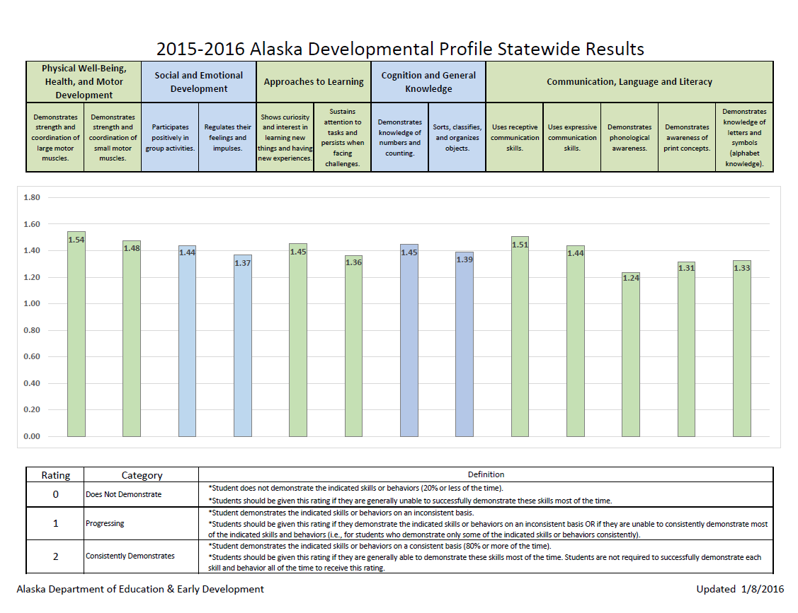
2015-2016 Alaska Developmental Profile Statewide Results

Slide 5
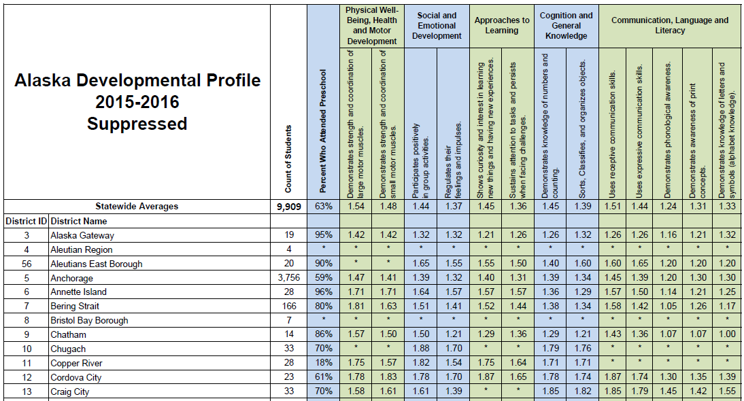
Alaska Developmental Profile 2015-2016 Suppressed

Slide 6
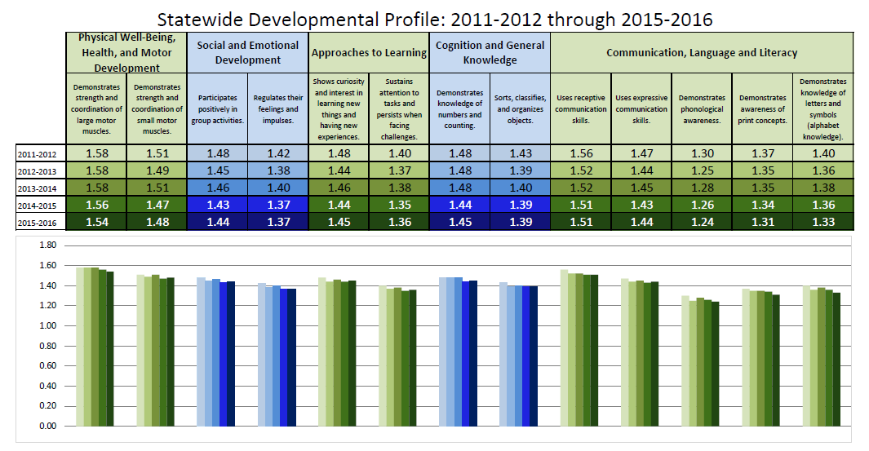
Statewide Developmental Profile 2011-2012 through 2015-2016

Slide 7
Why change how ADP results are reported?
Stakeholders should find the data actionable
How does one interpret an average rating?
Stagnant averages over time
Difficult suppression rules
An average rating can be the result of multiple possibilities – for example…
School with 20 kindergarten students
Average rating in Goal 1 of 1.00
All 20 students could have received a 1, or…
10 students received a 0 and 10 students received a 2

Slide 8
Future reporting
Instead of average ratings by goal, report the percentage of students receiving a 2 for each goal
Two new columns
Percentage of students who consistently demonstrated all 13 goals
Percentage of students who consistently demonstrated at least 11 of the 13 goals
Numbering of domains and goals for clarity
Remove the percentage of students who attended preschool

Slide 9
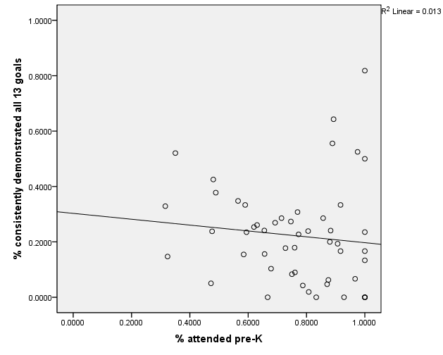
Relationship between attending preschool and ADP results

Slide 10
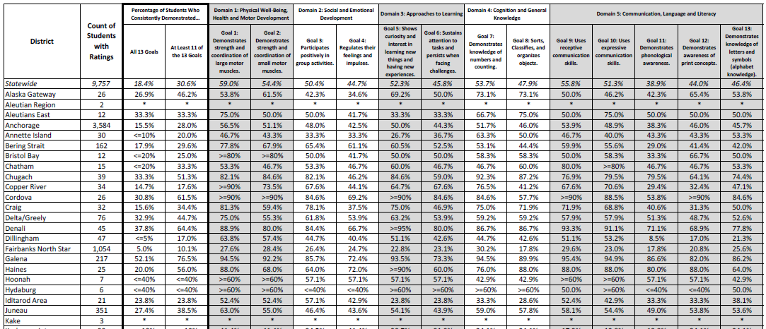
District-Level ADP results

Slide 11
Benefits of shift in reporting
Stronger representation of kindergarten readiness
Remove unnecessary data elements, and add ones that are beneficial
Ease of interpretation
Clarity for stakeholders
Easier suppression (two-way assessment suppression rules)
Full suppression vs. percentage ranges (e.g. <=40%, >=90%, etc.)

Slide 12
Statewide 2016-2017 results

