Slide 1
At-Risk Afterschool Meals
Outreach to School Districts
August 2015
Notes:
Photo from: http://meals4kids.org/afterschoolmeals (Massachusetts Department of Elementary and Secondary Education’s Child Nutrition Outreach Program)

Slide 2
Healthy, Hunger-Free Kids Act of 2010
On December 2, 2010, Congress passed a bill reauthorizing the Federal Child Nutrition Programs.
Signed into law by President Obama December 13, 2010.
The Act includes a provision that expanded eligibility for at-risk afterschool meals to all States.
Notes:
1994 – Program began in 1994 as a demonstration project and only reimbursed for snacks
1998 – Child nutrition reauthorization authorized CACFP reimbursement for snacks to children through age 18 in afterschool programs in all States
2000 – “Agricultural risk protection act” expanded the at-risk component to include reimbursement for suppers in 6 states
2000-2010 – Meal reimbursement expanded to more states and finally to ALL states in 2010, still relatively new program in Alaska

Slide 3
Good News in Alaska!
Started with School Year 2011-2012
Grew in 2014-2015 to:
Anchorage School District
24 sites for suppers
Haines Borough School District
1 site for supper
Mat-Su Borough School District
3 sites for suppers
Petersburg Borough School District
1 site for supper
Notes:
Began with 2 districts and 15 sites in 2011, grew to 4 districts participated last year with a total of 29 sites around the state

Slide 4
Program Eligibility
Schools with 50% or greater free/reduced-price school meal eligibility
Must have regularly organized, supervised educational or enrichment activity outside school hours
Examples:
21st Century Programs
Homework Help, Arts & Crafts, etc.
Remedial education
Organized fitness activities
Notes:
So, how can a school establish eligibility? In At-Risk, area eligibility using F/R School Meals data is the only option and as with SFSP, the school must have 50% or more children eligible for F/R Meals
The other eligibility piece is that the school or site must have regularly scheduled, supervised educational or enrichment activities such as…

Slide 5
Program Eligibility - Activities-
May contract with another organization to provide the activities
No requirement that the children receiving meals participate in the offered activities
Cannot be limited to a sports team – but sports teams can receive meals as part of broad educational or enrichment program
Notes:
Cannot be limited to sports team… such as only the basketball team after practice, but meals and snacks maybe served in commons for all kids including basketball players

Slide 6
Meals only during the regular school year
Afterschool snack and/or afterschool meal
One meal and/or one snack per child per day (must have the activity program on the same day around the meal time)
If you have activity program on a Saturday you can have a snack or meal with that activity program
Notes:
Weekend programming such as Saturday school for example can receive meals

Slide 7
Meal Times
Meal times will vary depending on your activities – can have supper before 5:00 p.m.
Meal time must occur during the operation of the school’s afterschool care program

Slide 8
Participant Eligibility
18 or under at start of school year
No requirement that each facility must serve the full age range of eligible children
High school program could serve only high school students
And persons of any age who meet the definition of “persons with disabilities” 7 CFR 226.17a(c)
Non-residential students attending afterschool activities at a residential center (RCCI)
Cannot claim the residents
Notes:
Persons with disabilities means persons
of any age who have one or more disabilities,
as determined by the State,
and who are enrolled in an institution
or child care facility serving a majority
of persons who are age 18 and under, meaning educational activities
RCCIs: For example, Covenant House in Anchorage has an outreach program on Tuesdays for homeless students and their meals can be claimed because they do not reside at Covenant House

Slide 9
Meal Patterns and Food Service
You’ll need to choose which meal pattern you will be following:
CACFP meal pattern, or
NSLP meal pattern
If following NSLP – OVS is not an option during snack service

Slide 10
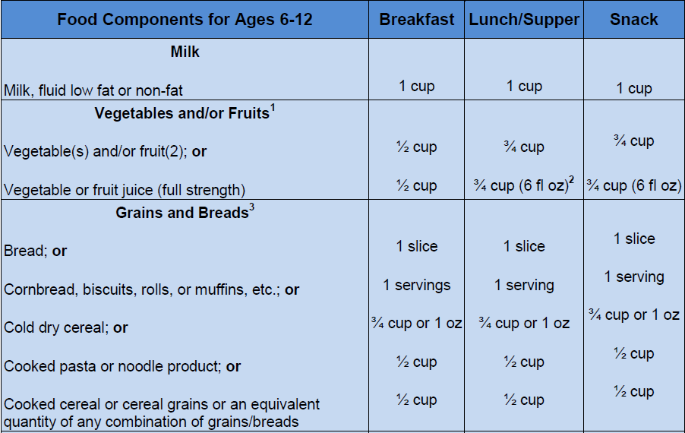
CACFP Meal Pattern for At-Risk Meals
Notes:
CACFP Meal Pattern is easier than NSLP but changes are coming with more nutritional standards/requirements

Slide 11
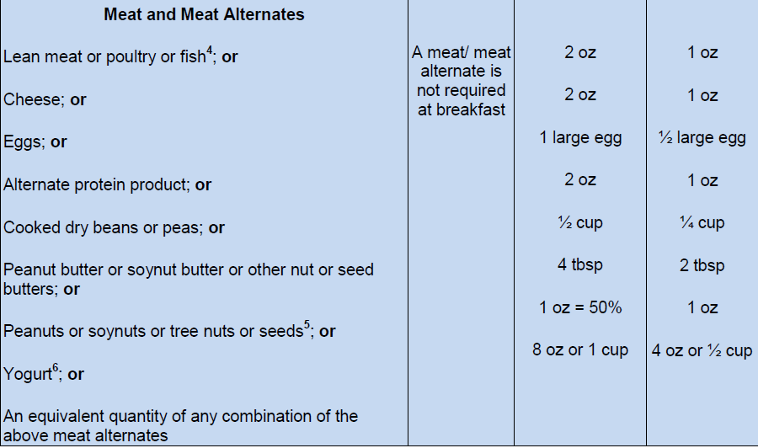
CACFP Meal Pattern for At-Risk Meals

Slide 12
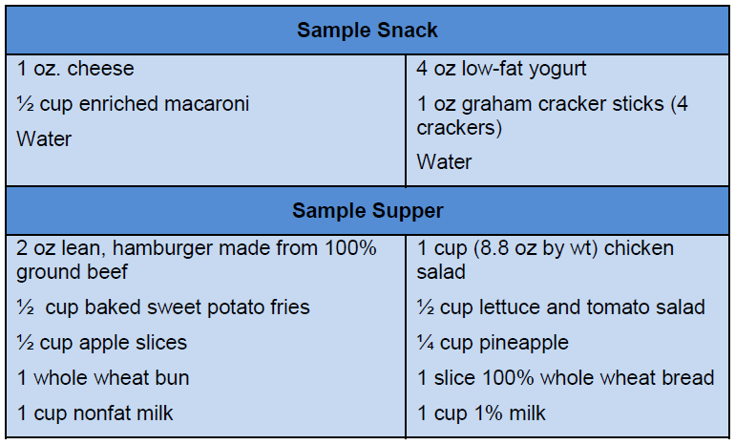
Sample Snack & Supper

Slide 13
Application for School Districts
At-Risk Afterschool Meals Addendum
Educational/enrichment activities
Meal types to be served
School sites, % free/reduced, dates
Procedure for recording and collecting records from each site
Daily attendance
Point of service meal counts
Cycle menus
Notes:
The lets us know who is responsible for the program and what their roles are

Slide 14
CNP Database Requirements
Names, home mailing addresses and dates of birth of the responsible principals and individuals
Preference for commodities or CIL
Ineligibility for other publicly funded programs
Certification that all information is true & correct
Notes:
Ineligibility for other publicly funded programs (Sam.gov)

Slide 15
Reimbursements
All meals and snacks reimbursed at FREE CACFP rate (2014-2015):
Breakfast: $2.66
Lunch/Supper: $4.99
Snack: $1.37
Lunch & Supper Cash in lieu of Commodities rate: 23.75 cents
Notes:
Lunch can only be served on school holidays or weekends

Slide 16
Recordkeeping
Daily Attendance Rosters or Sign-in Sheets
Number of at-risk snacks and/or meals prepared or delivered for each meal service
Daily record of number of at-risk snacks and/or meals served at each snack and/or meal service; and
Daily record of number of meals, by type, served to adults involved in the meal service
Notes:
Adults meaning “program adults” or those only involved in the necessary operation of the meal service

Slide 17
Recordkeeping
Documentation that meal pattern met:
Menus for each at-risk snack and/or meal
Working menus/production records/recipes
Self-monitoring forms completed
Two self-monitoring visits per year
Use new NSLP At-Risk Afterschool Meal Program On Site Review Form for School Districts
Submit on-site review summary to EED NSLP staff
Keep on file with your other NSLP self-monitoring reports
Notes:
Monitoring: continue using NSLP forms, submit on-site review summary to NSLP staff (Debbie)

Slide 18
State Administrative Review
Your At-Risk Afterschool Meals program will be monitored when you have your NSLP review
CACFP Monitoring form will be used for the CACFP administrative review

Slide 19
Ann-Marie Martin (907) 465-8711 annmarie.martin@alaska.gov or Alicia Stephens (907) 465-4788 Alicia.Stephens@Alaska.gov

